Slide 2
LRP_MB update 22/July/2024
Mini-sensor ready
What’s firest year’s test like
LRP plot update (both SL and RL) (channel relocate FC34 C34+-)
MB without baseline
Next step: SSVEP and EMG (find decision commit time)

Slide 3
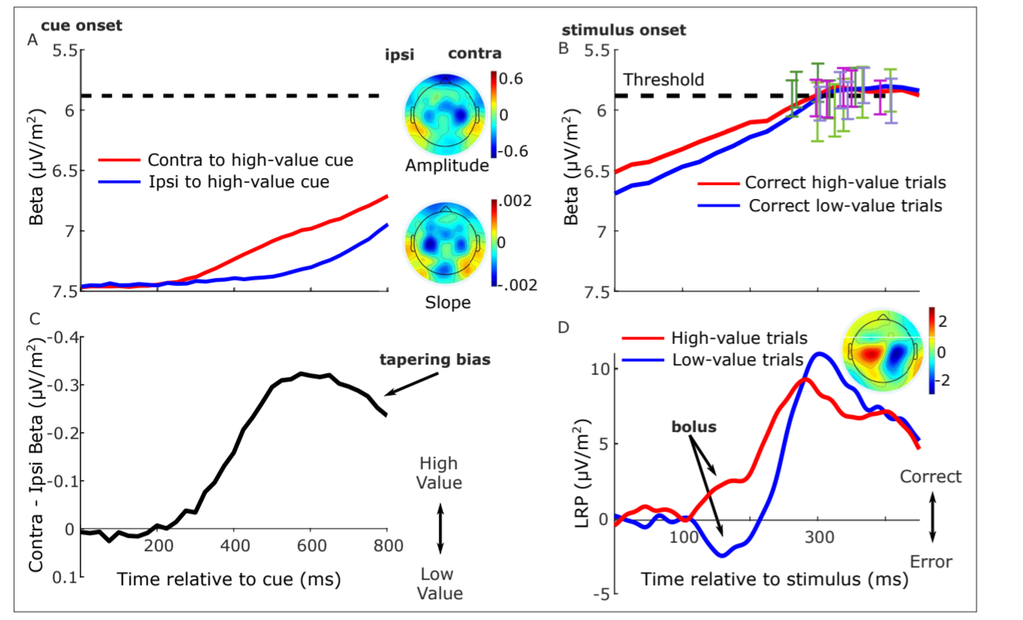
LRP analysis
For SL, 0 is evidence on; colour bar limit [-30-30]
For RL, 0 is trail end, app. Respond time is -233ms; colour bar limit [-8 8]
All based on participant response ? (should check correct resp.)

Slide 4
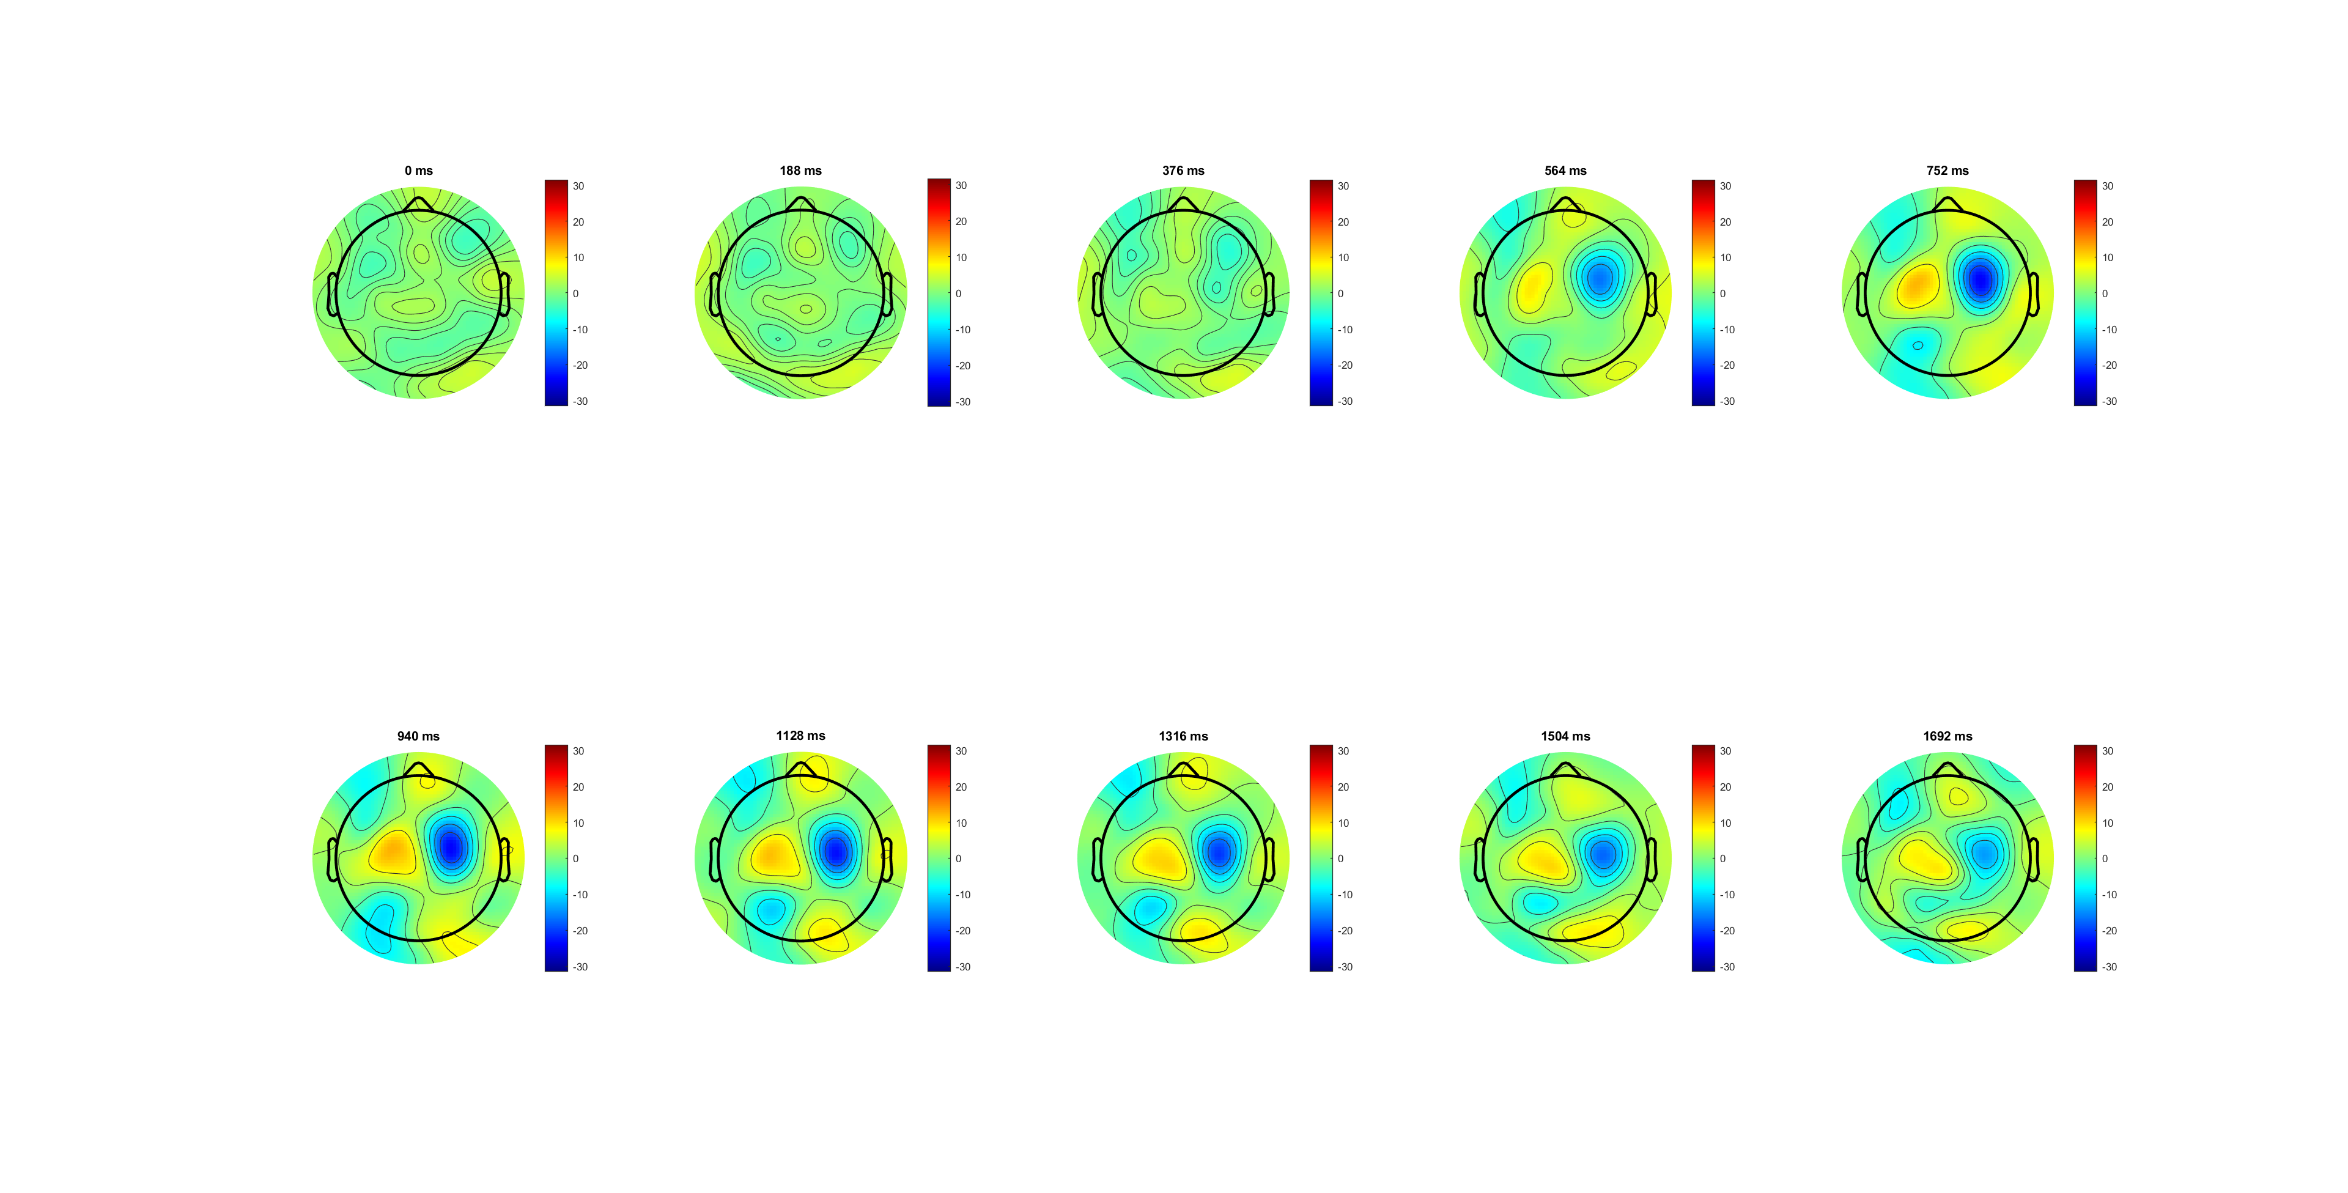
Patten (L-R) starts from 500ms;
No matter participant resp. is C or W, have this patten
Location close to FC3/4
avg acc 82%
Correct
participant response
SL, 0 is evidence on

Slide 5
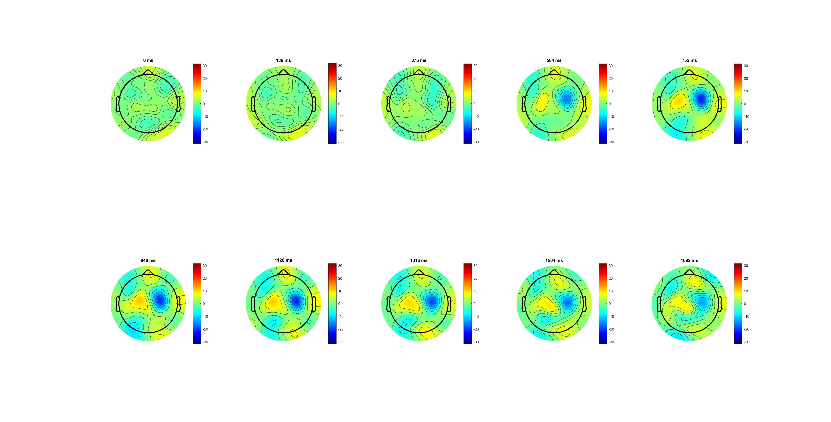
Wrong
participant response
SL, 0 is evidence on
Notes:
左减右，500秒左右出现了不对称
只要动了手不管正确错误都有,对称蓝黄模式出现
位置靠近FC34

Slide 6
C34
Clearer at FC3/4
After evidence on (300ms) shows the diff.
Correct steeper slope
Correct higher amplitude in the end
FC34
participant response
SL, 0 is evidence on
Notes:
FC 34更清晰，right -wrong
显示在evidence on 后出现差异
Correct slope 更大，反超wrong且amplitude更高

Slide 7
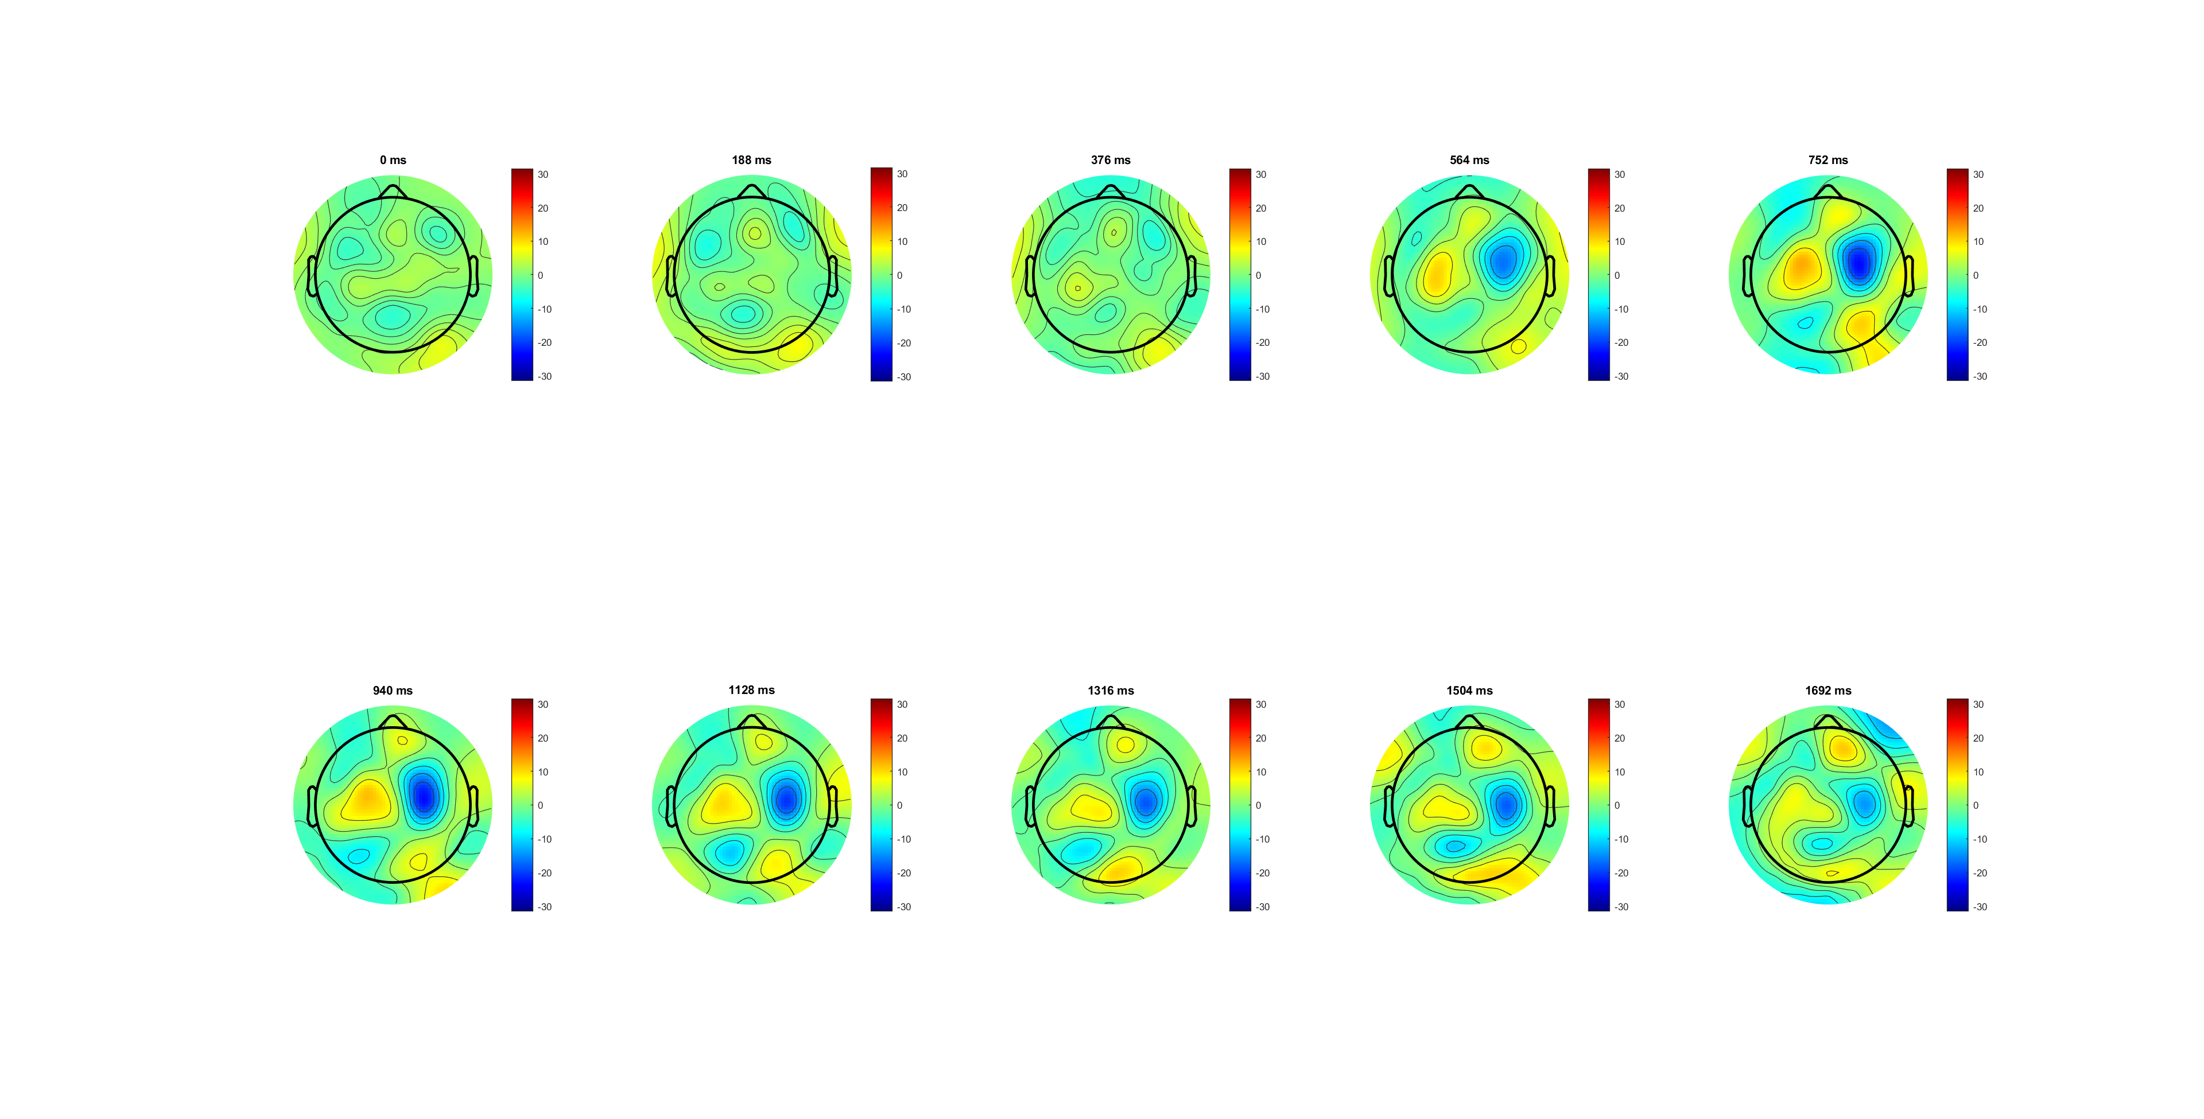
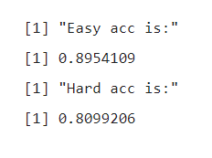
High 0.14 have higher amplitude/ peak (@940) and fade faster
Low 0.07 after 840ms existing longer
High 0.14
participant response
SL, 0 is evidence on

Slide 8
Low 0.07
participant response
SL, 0 is evidence on
Notes:
高数值高且peak早，
低peak晚且持续久
FC34更清晰

Slide 9
C34
FC34
For FC3/4:
high 0.14 have higher amplitude
high 0.14 have steeper slope in both increasing and decreasing period
participant response
SL, 0 is evidence on
Notes:
high斜率更大且到达peak更高

Slide 10
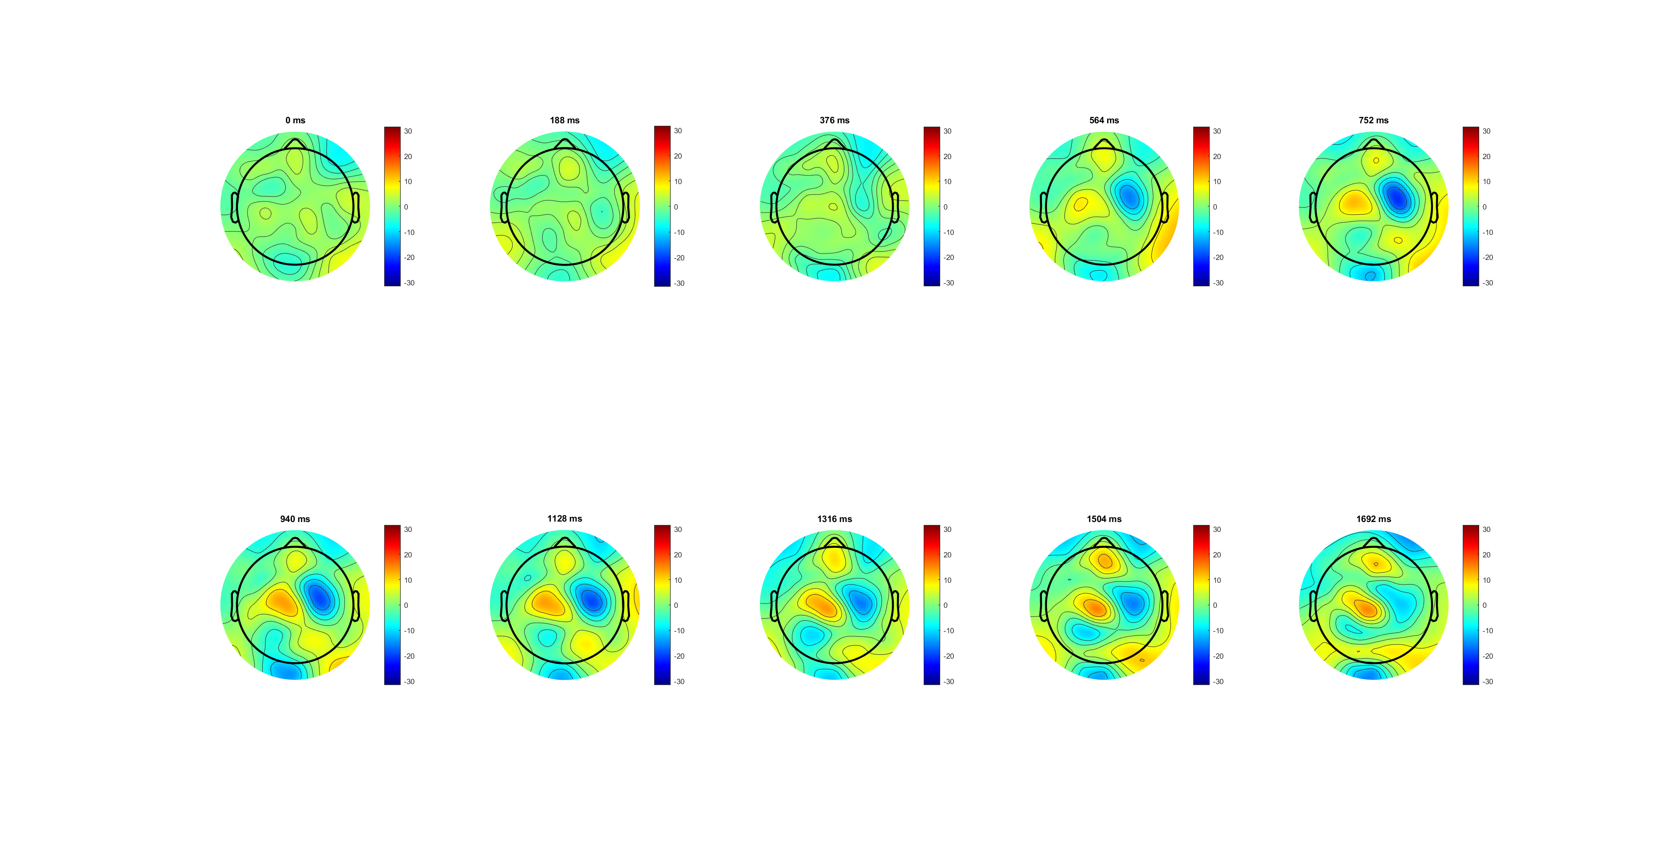
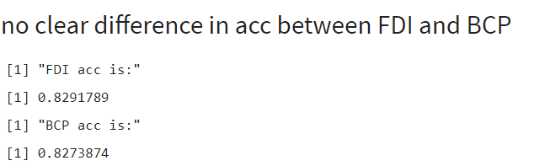
Similar acc
Have different patten in scalp plot
FDI
participant response
SL, 0 is evidence on

Slide 11
BCP
participant response
SL, 0 is evidence on

Slide 12
FC34
BCP higher amplitude in SL
Same slop
FC34 (correct)
participant response
SL, 0 is evidence on
Notes:
BCP LRP

Slide 13
RL
For SL, 0 is evidence on; colour bar limit [-30-30]
For RL, 0 is trail end, app. Respond time is -233ms; colour bar limit [-8 8]

Slide 14
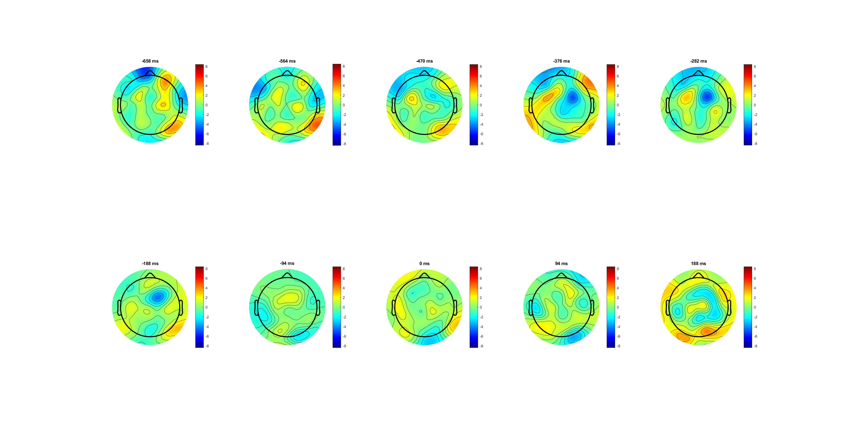
Correct
participant response

Slide 15
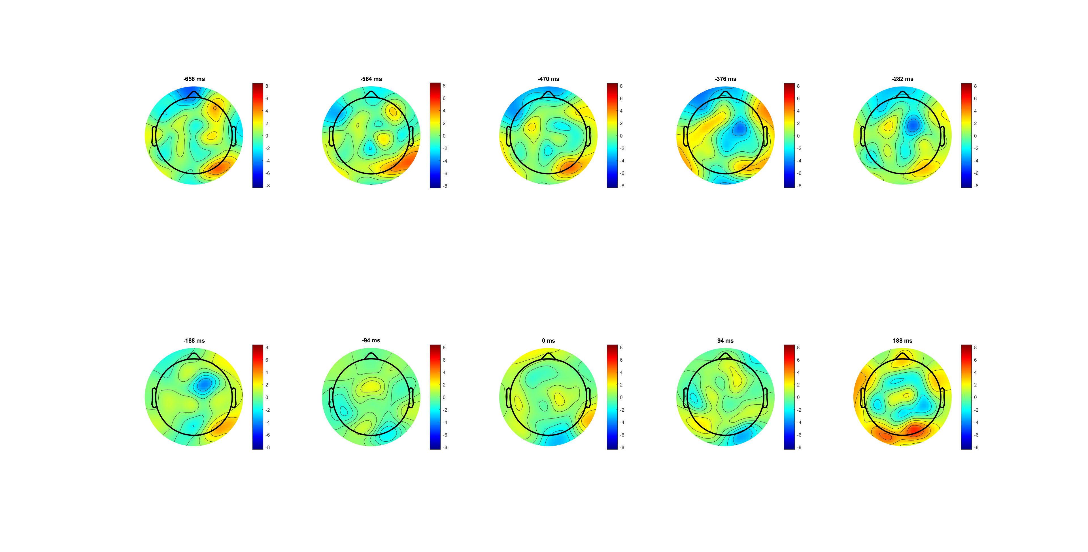
wrong
participant response

Slide 16
RL LRP have no observious diff between C and W
Location at FC3/4
Peak (282) just before response(-233)

Slide 17
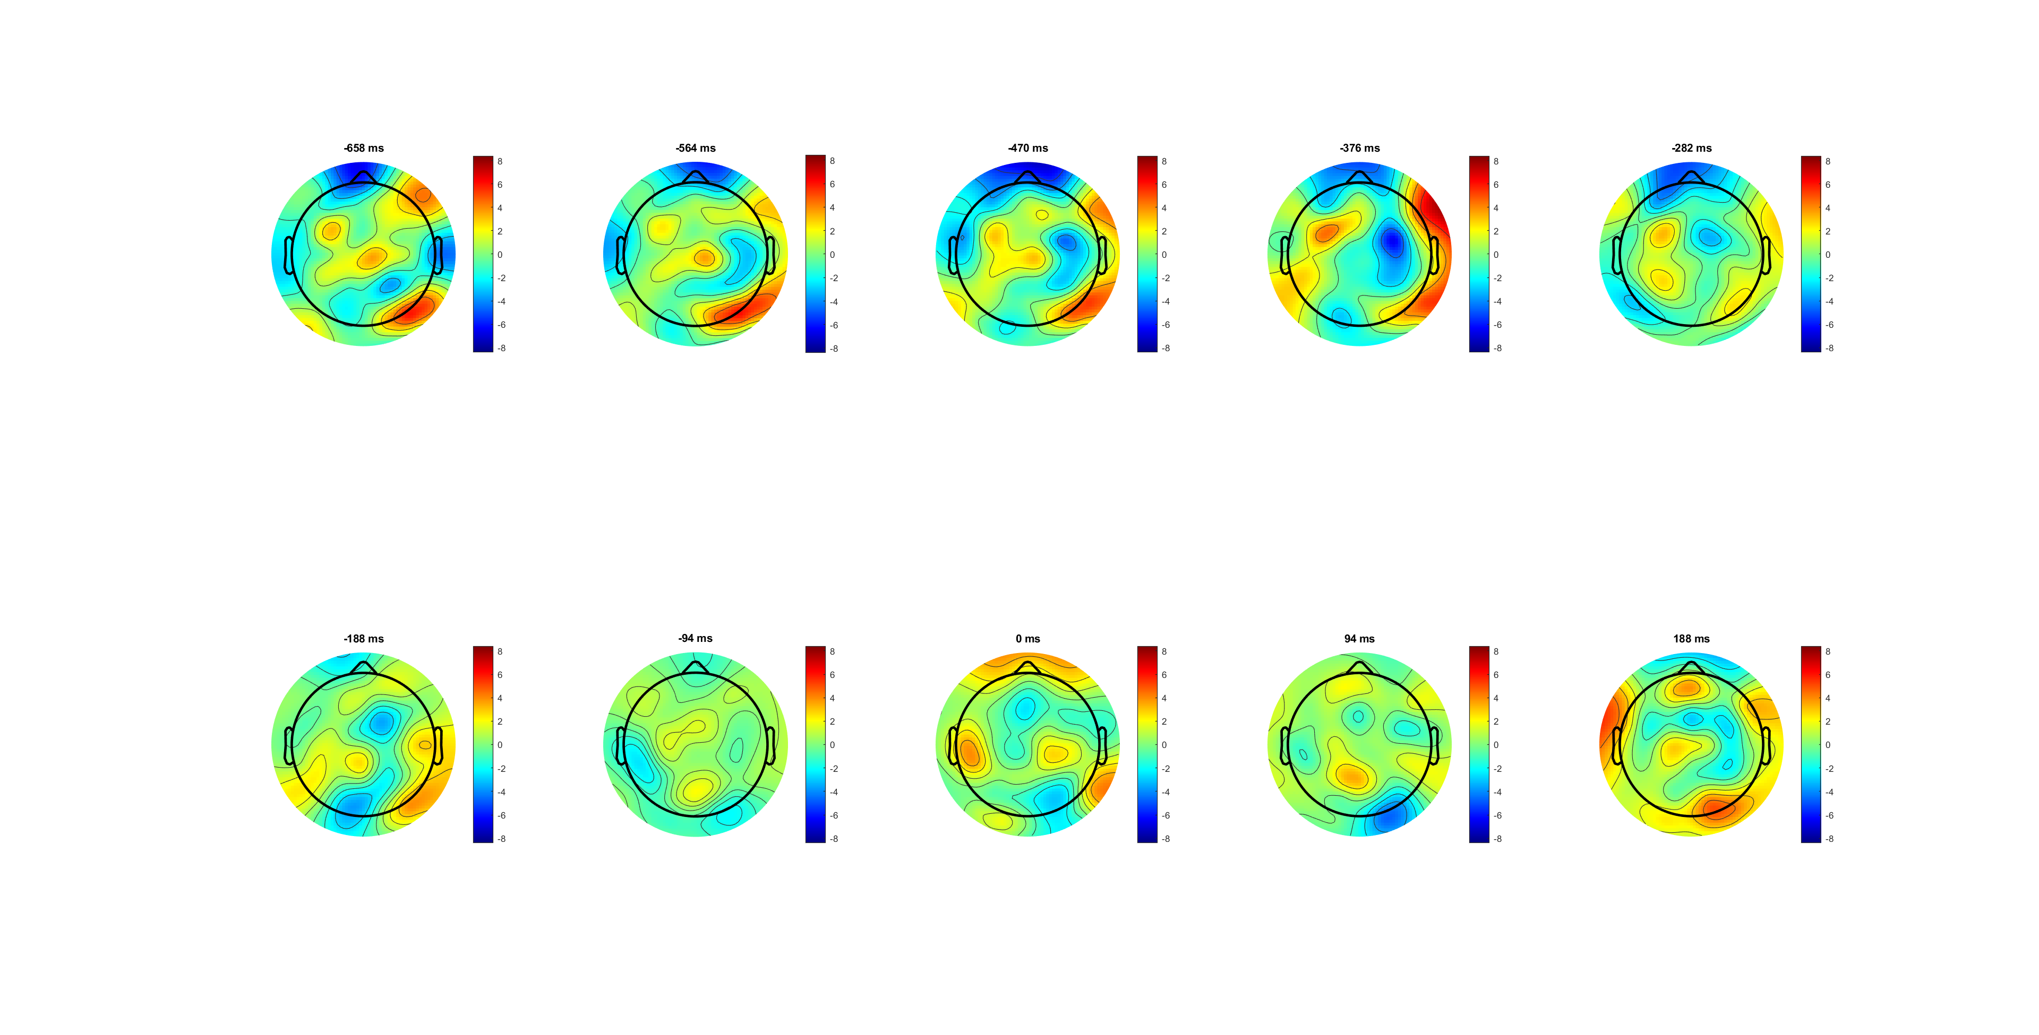
High 0.14
participant response

Slide 18
Low 0.07
participant response

Slide 19
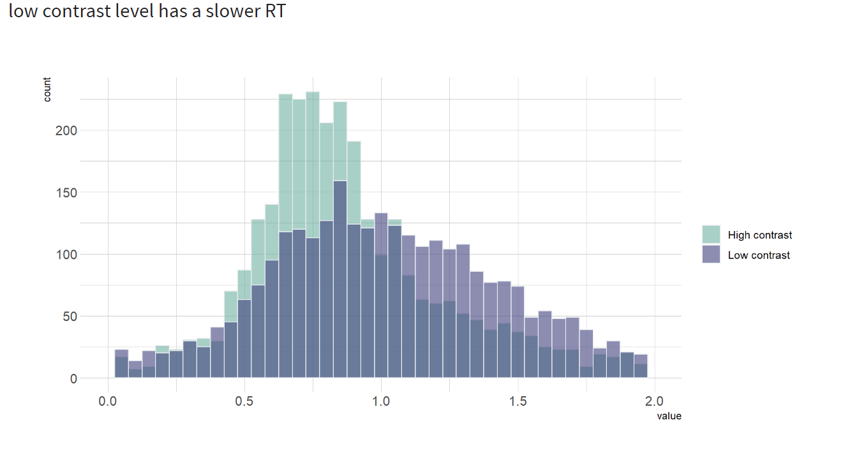
High 0.14 have higher amplitude before response
Peak (282) just before response(-233)
participant response

Slide 20
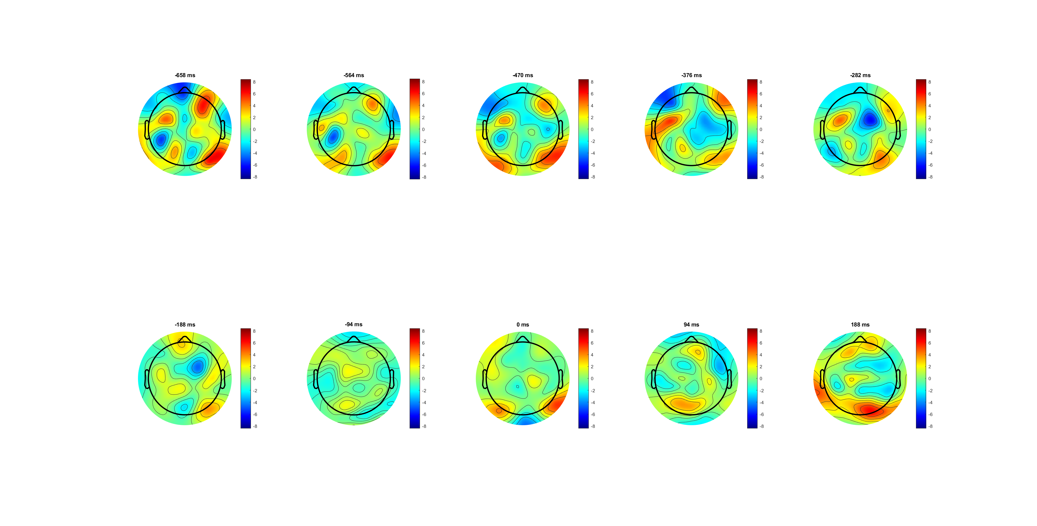
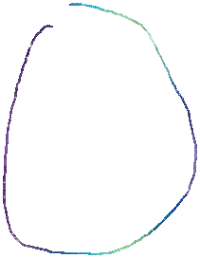
FDI correct
FDI’s patten is wider and centra
BCP is closer to frontal area and narrower
participant response

Slide 21
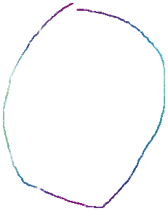
BCP correct
participant response

Slide 22
participant response

Slide 23
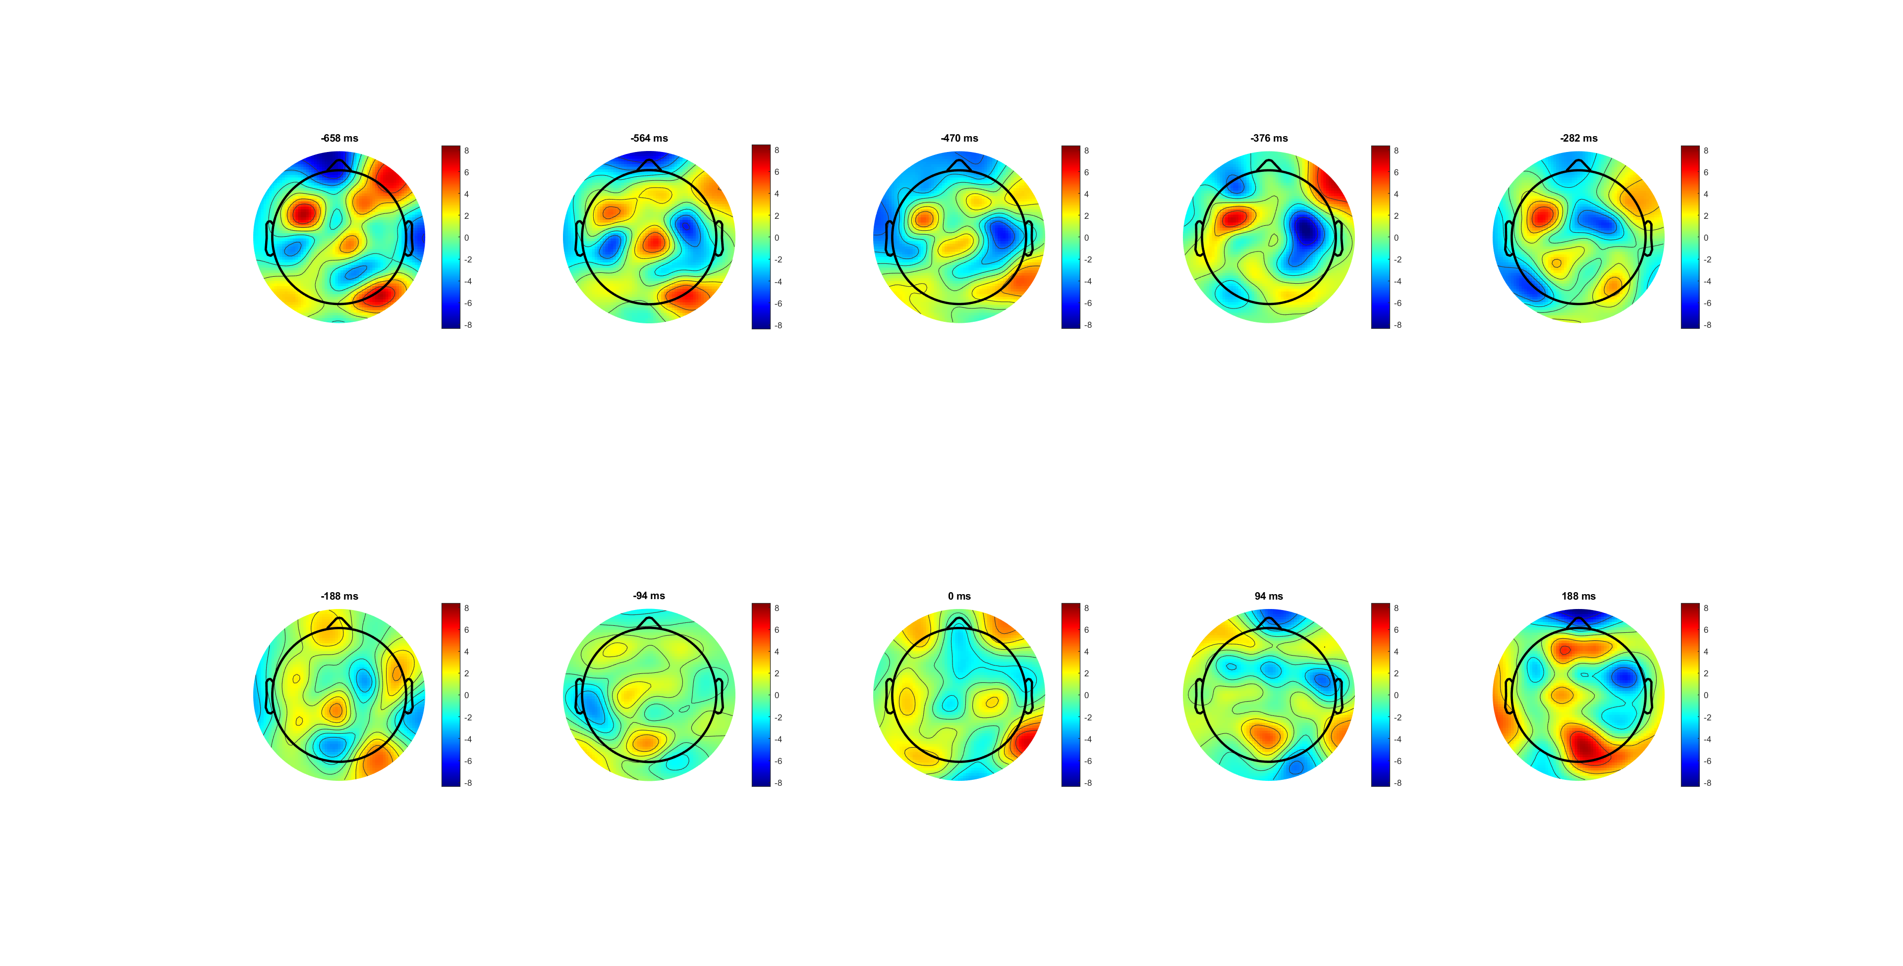
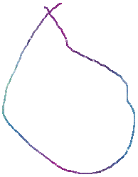
FDI correct high
FDI’s patten is wider and centra
BCP is closer to frontal area and narrower
participant response

Slide 24
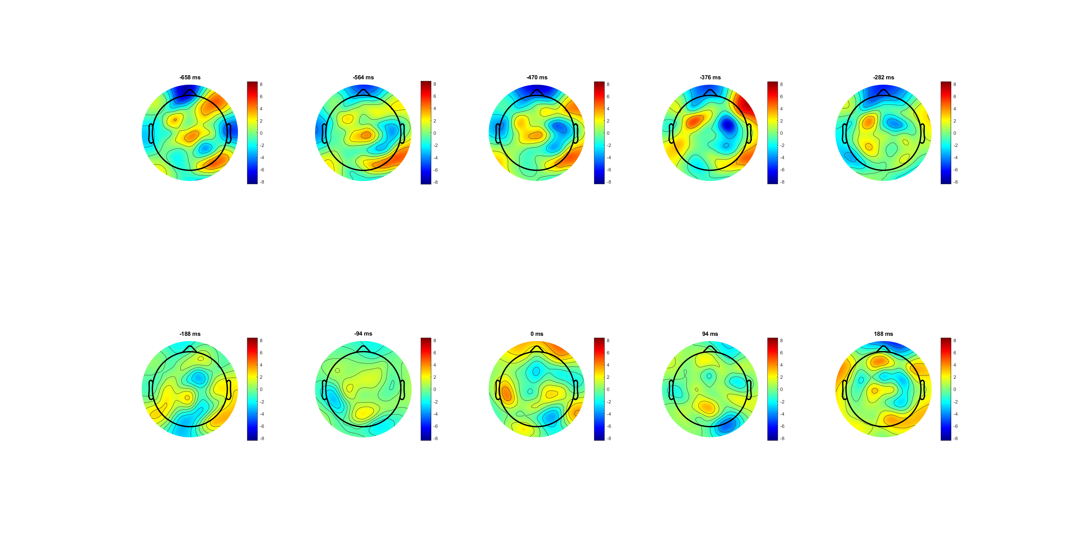

BCP correct high
participant response

Slide 25
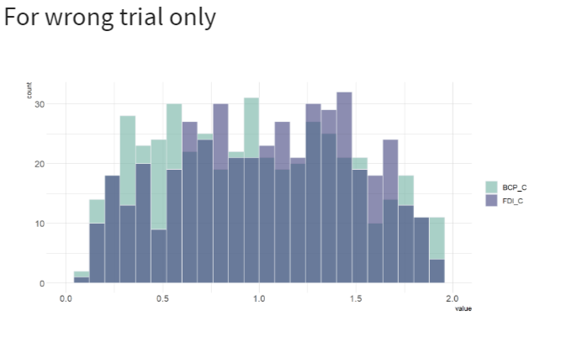
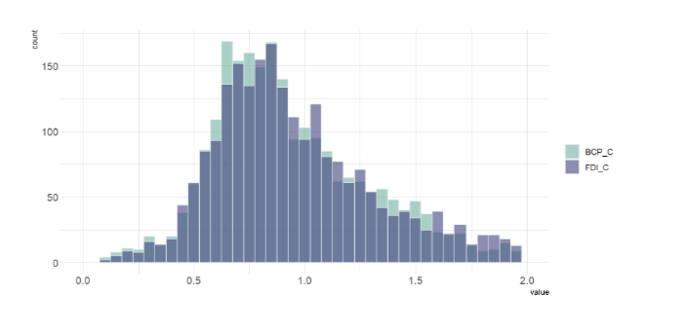
FDI higher amplitude in RL\
In plot below FDI RT slightly faster (P<0.05)
For both correct and wrong trials
participant response

Slide 26
MB analysis
Wrong and low 0.07 have higher MB amplitude
BCP higher MB amplitude
Location: FDI wider and middle; BCP narrower and frontal
Hypo: first time decide direction, second ensure muscle used?? (no FDI/BCP ready, just ready)

Slide 27
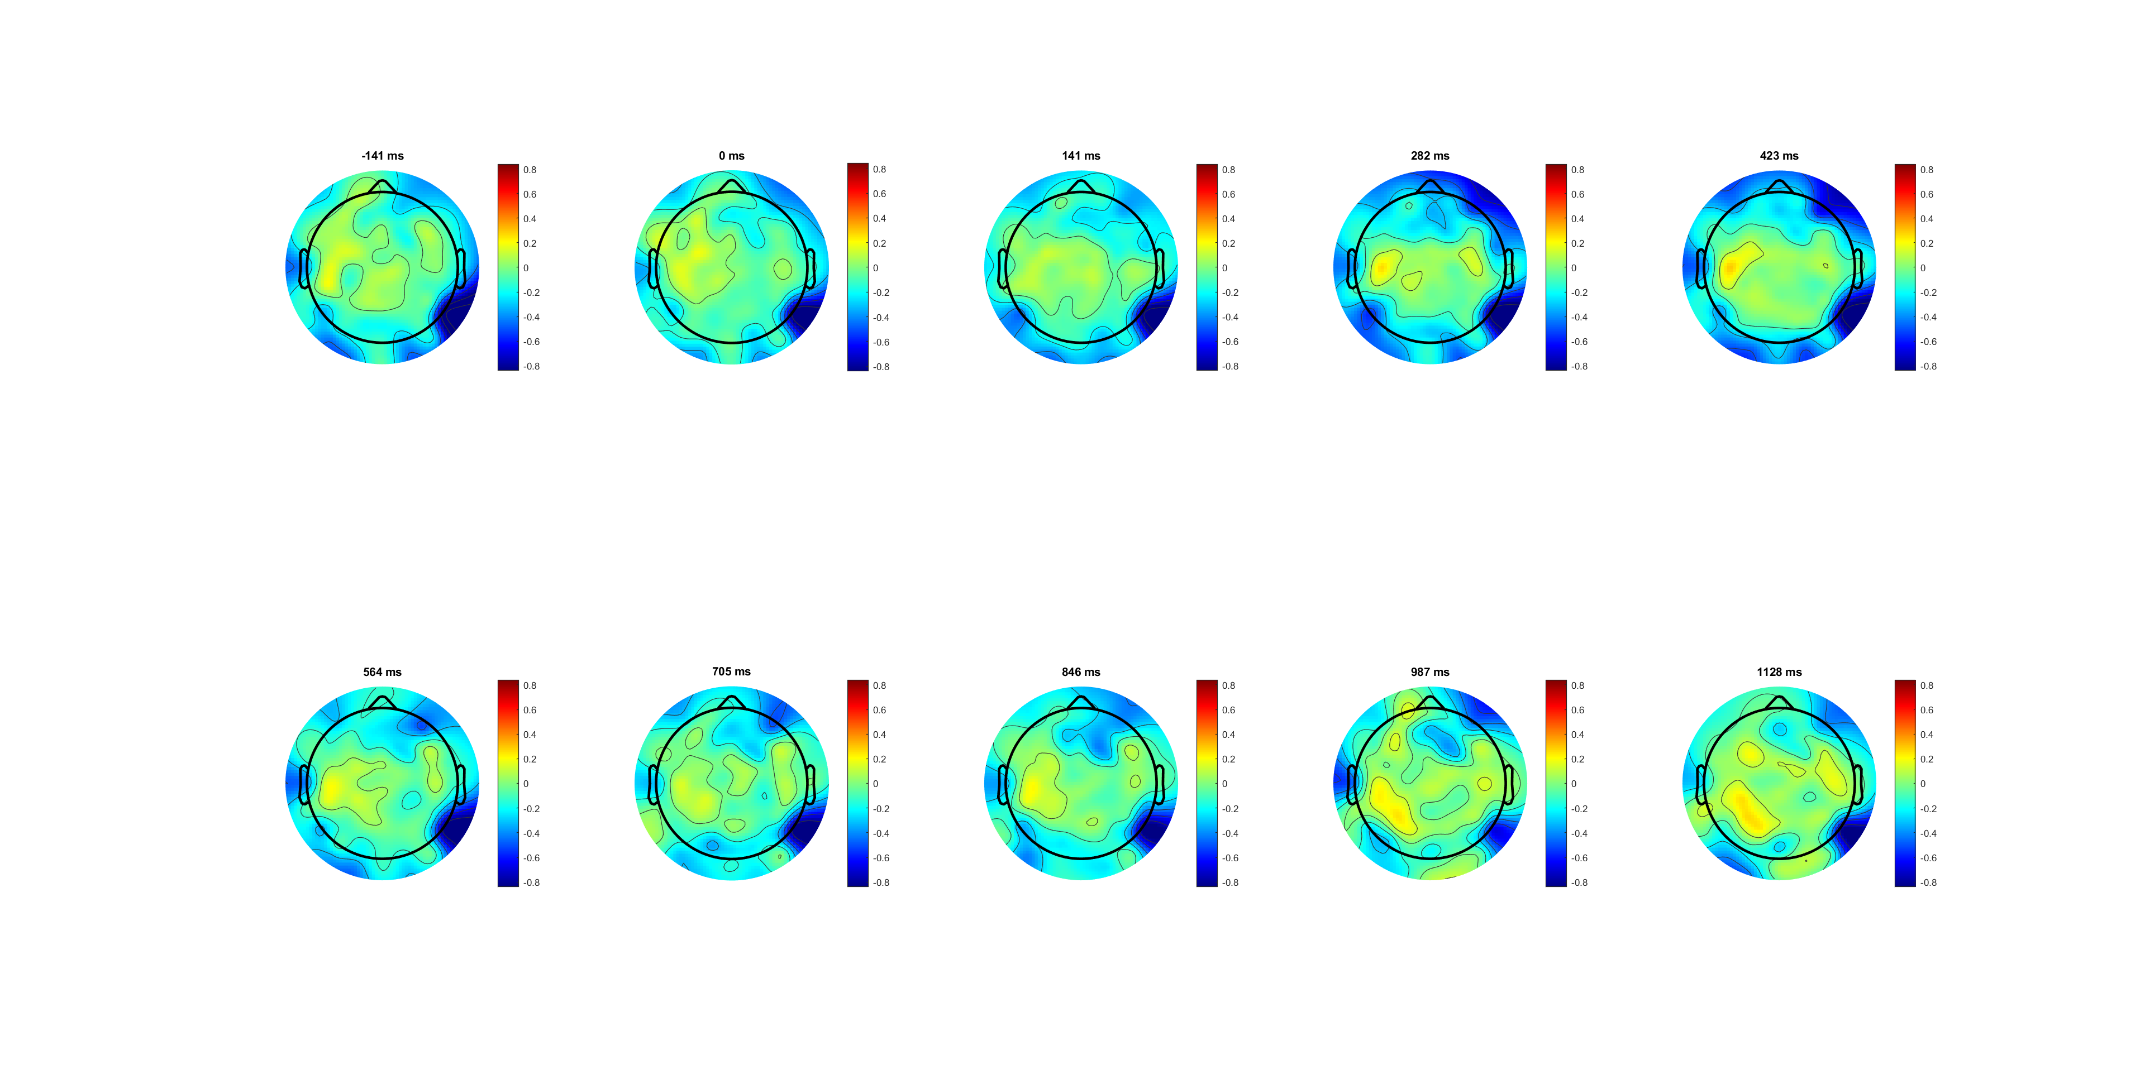
Correct_SL +-0.8
Two patten:
C3/4+ starts 282 then fade at 705
C3/4 back starts 967 (average response time!)
Notes:
282升高降低再900升高，c34+或者位置靠后

Slide 28
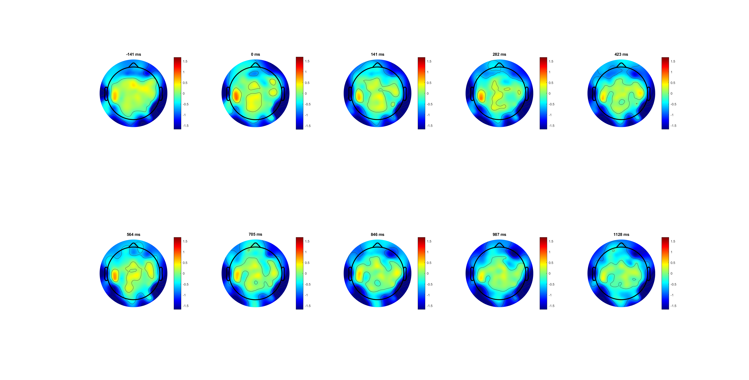
Wrong Sl +-1.6
Wrong don’t have patten two
But have patten one
Higher diff. between left-right response (not cotra-lipsi)
Notes:
持续存在，且amiplitude更高，可能位置偏后脑勺（排除掉C34+）

Slide 29
Correct vs wrong （different channel）
C3/4+:
Correct upper than wrong
Contra upper than ipsi
Different saturation level
Stable and observes Lateralisation
C3/4 back:
Same saturation level
Small Lateralisation
Notes:
C34+正确比错误上方，con比ipsi上方，有不同阈值线，且Lateralisation 存在/明显
靠后位置，起始点不同，阈值相同，Lateralisation不明显

Slide 30
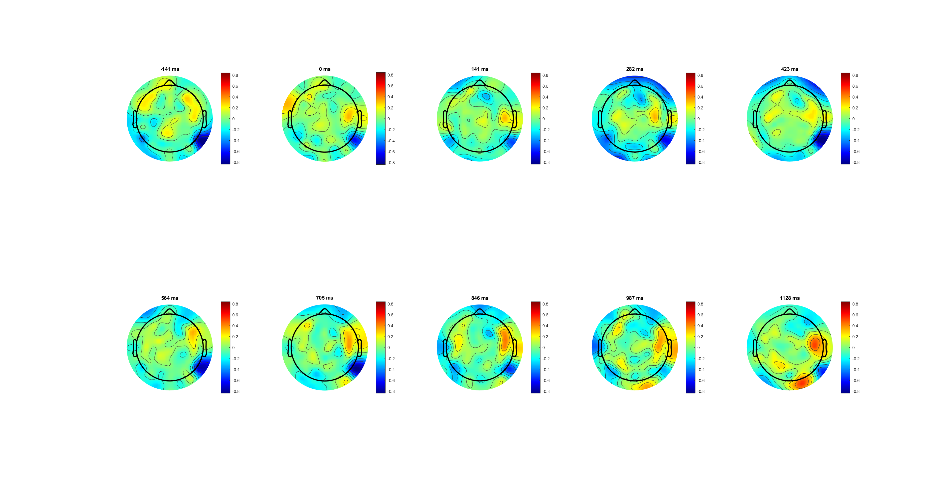
High correct
Still have Two patten:
But here’s a third patten hard to explain (only in high 0.14)
Low 0.07 have higher diff between L-R
Notes:
不知道右上角是什么

Slide 31
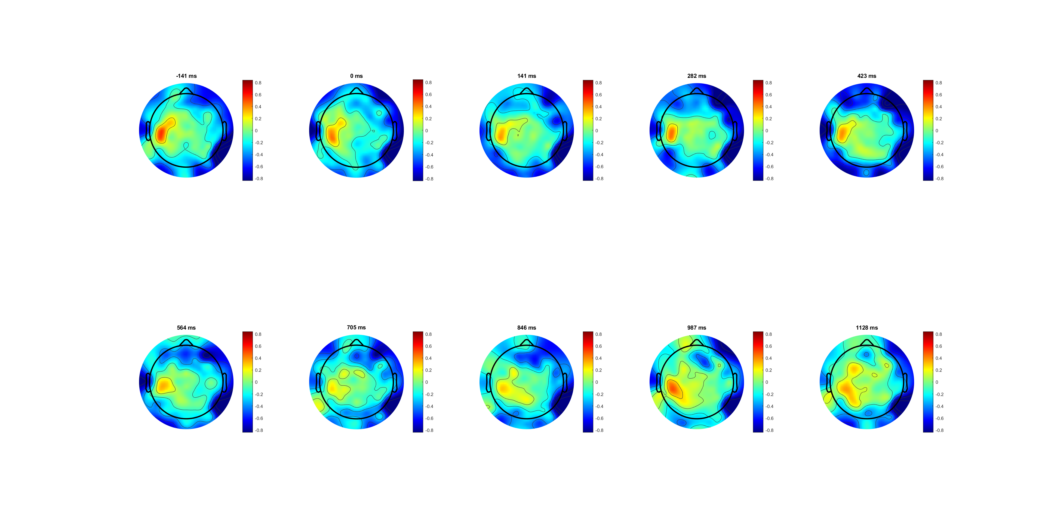
Low correct
Patten one and two observed

Slide 32
Low 0.07 upper than high 0.14
Contra upper than ipsi onlyb in low
saturation only shows in high
Stable and observes Lateralisation in low
Seems High and Low have diff. internal brain strategy
Notes:
1. 低的没饱和趋势，contra有差异，ipsi无

Slide 33
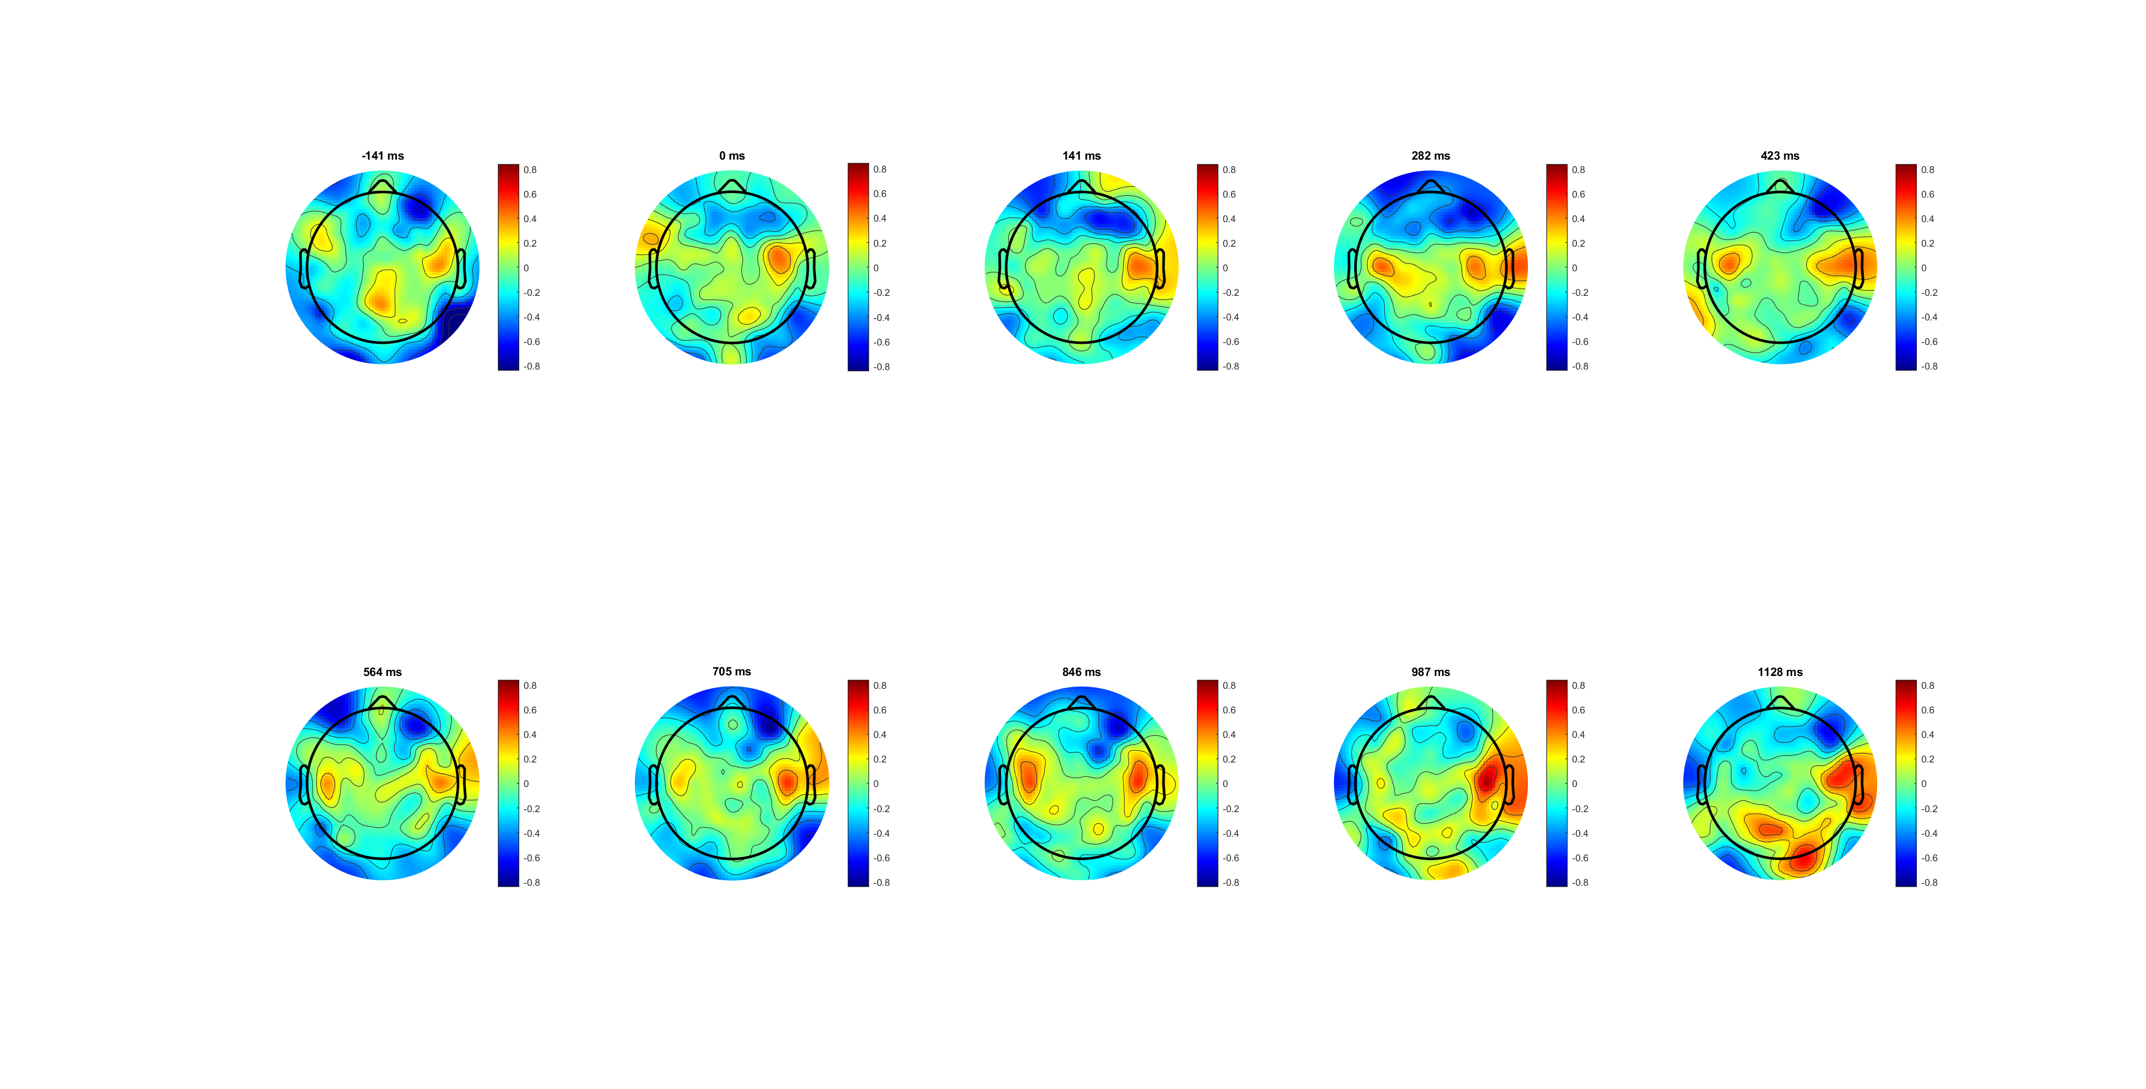
FDI correct high
brain strategy one:(for easy task)
Different location found! FDI wider and middle; BCP narrower and frontal
Peak and fade pattern exists: (see 900/appo. Resp. time) Hypo: first time decide direction, second decide muscle?? (no FDI/BCP ready, just ready)

Slide 34
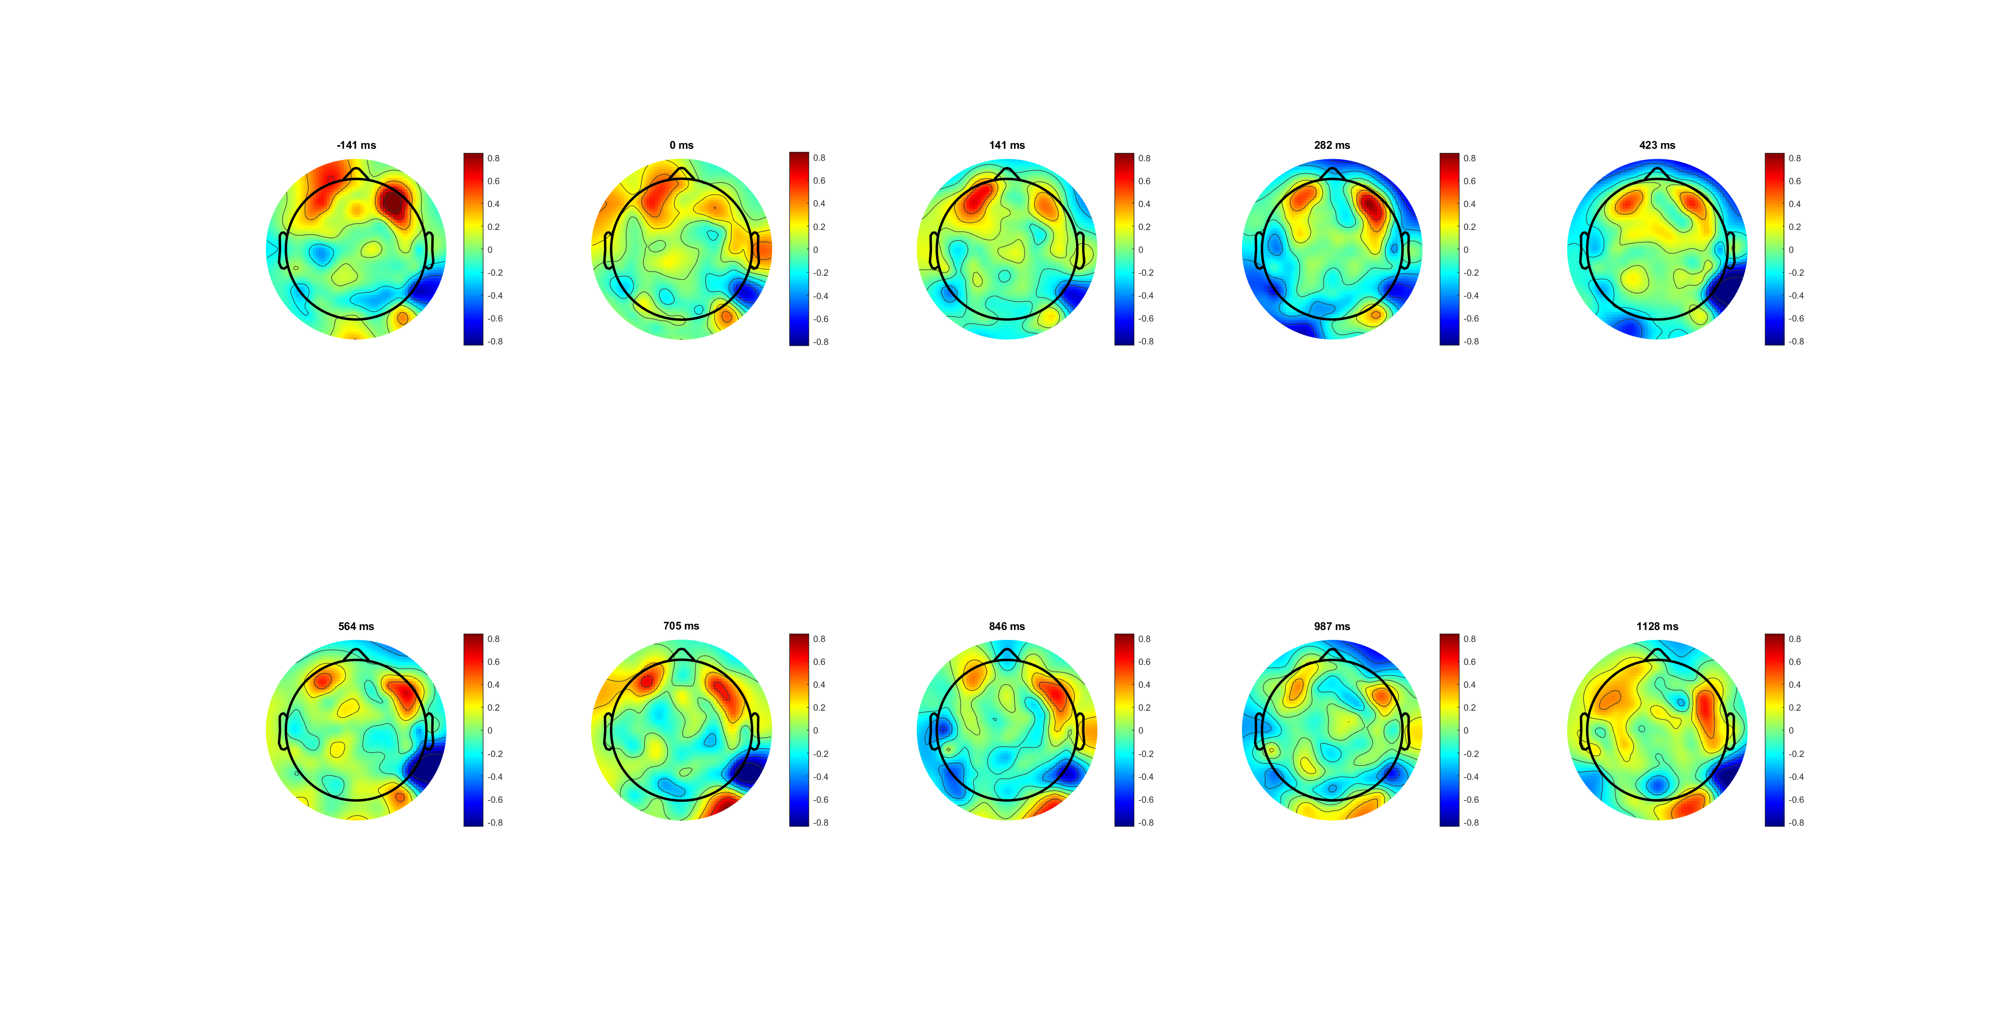
BCP correct high

Slide 35
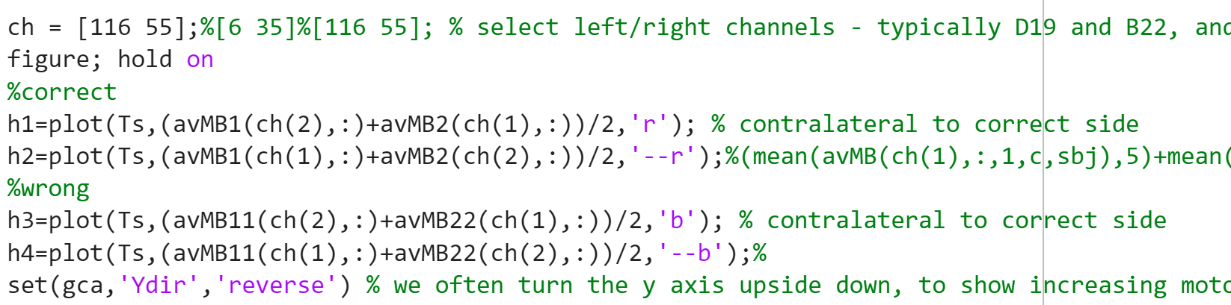
Because different location
Can’t compare between FDI and BCP using same channel,(better way?)

Slide 36
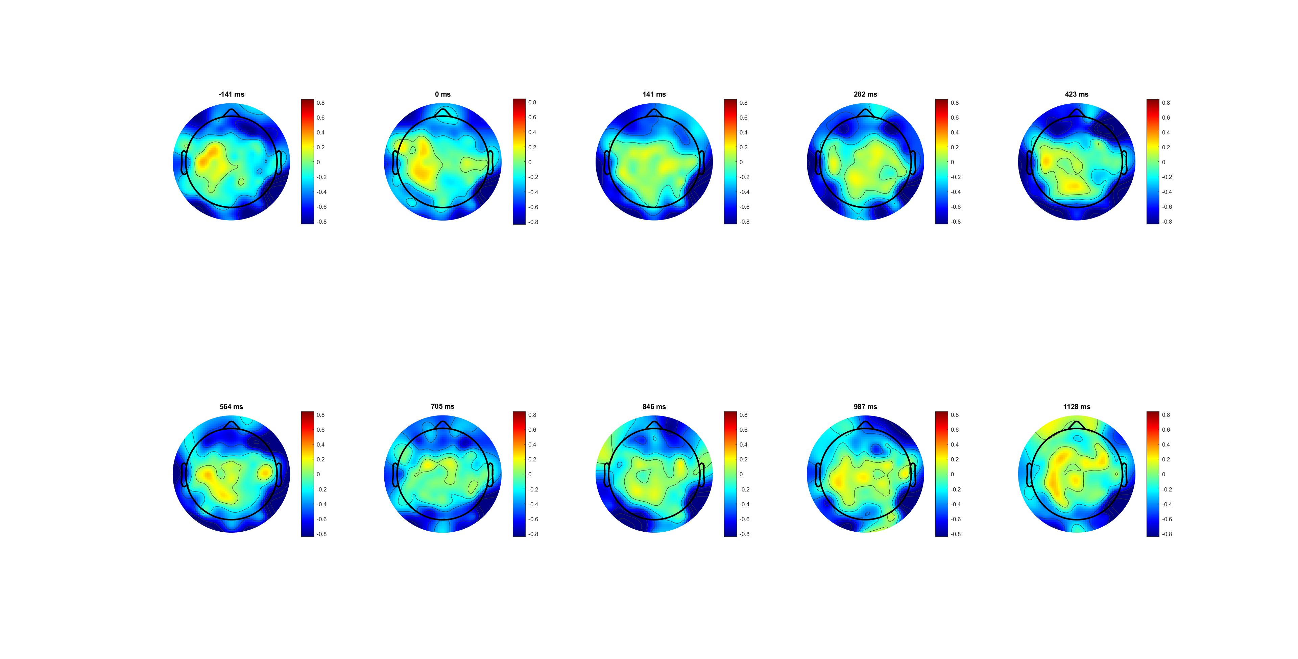
FDI correct low
BCP higher amplitude in low

Slide 37
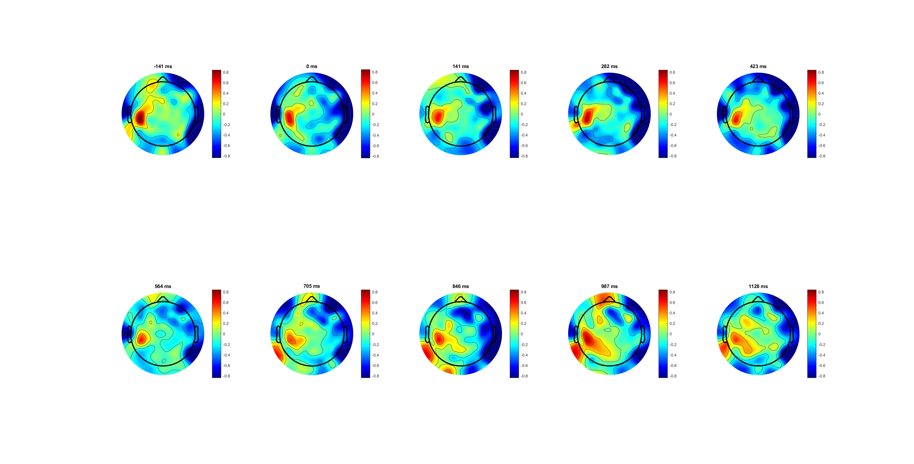
BCP correct low

Slide 39
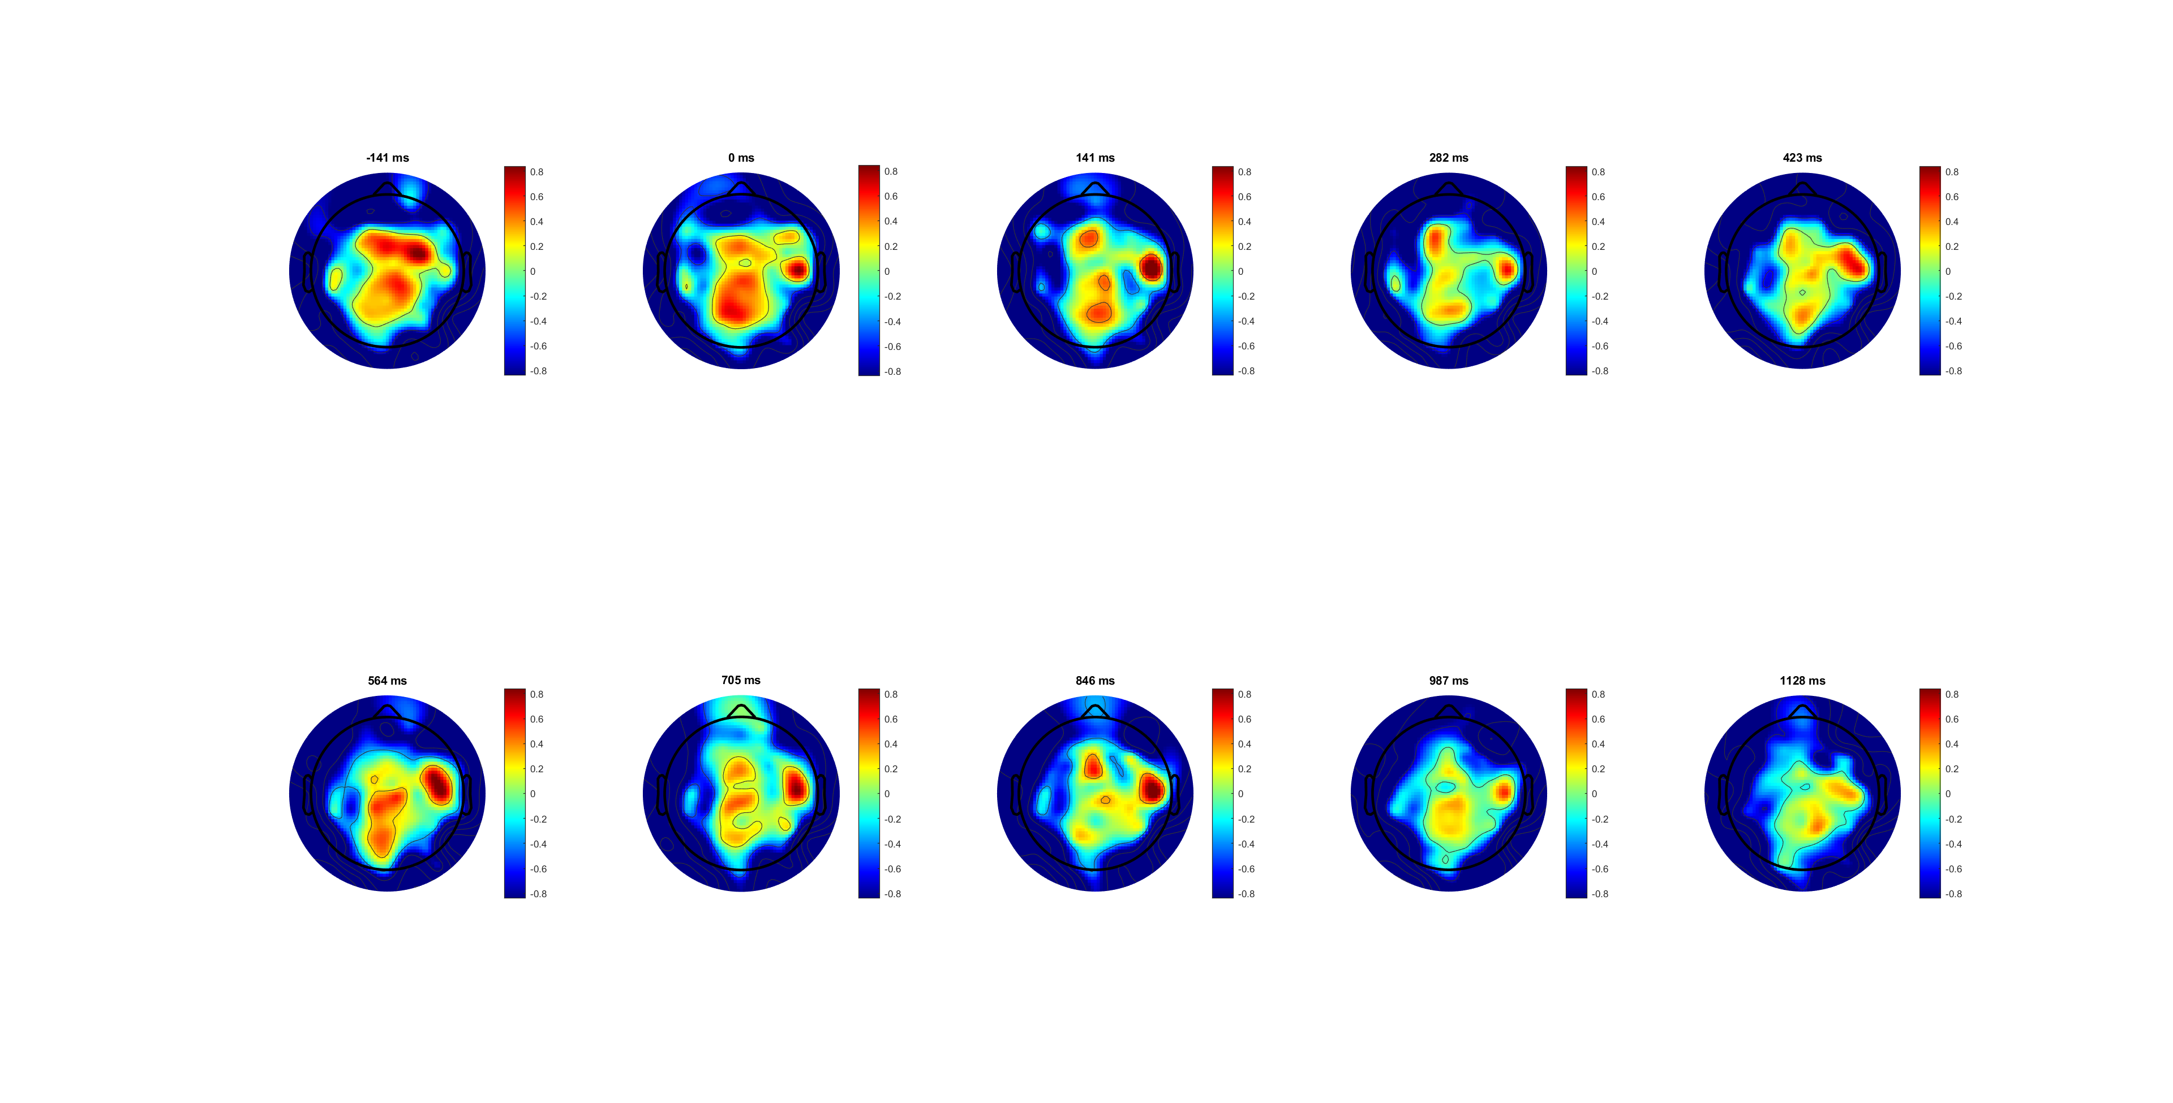
FDI wrong

Slide 40
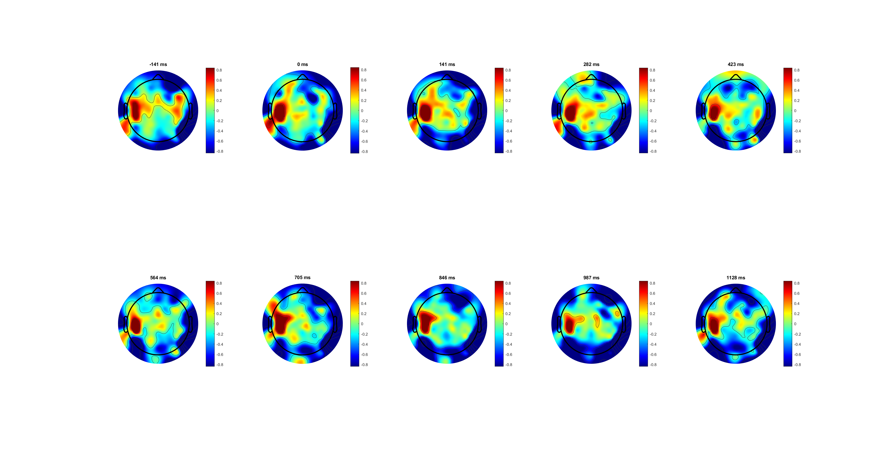
BCP wrong

Slide 42
RL
See FDI vs BCP first

Slide 43
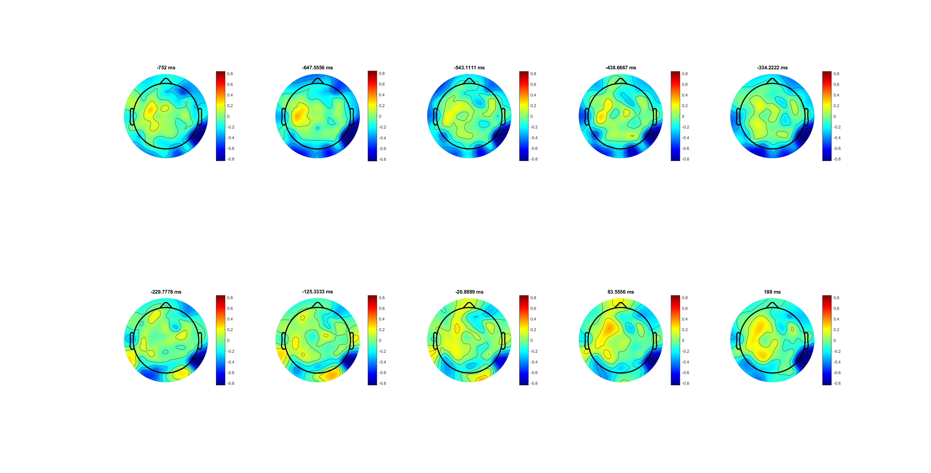
Right RL

Slide 44
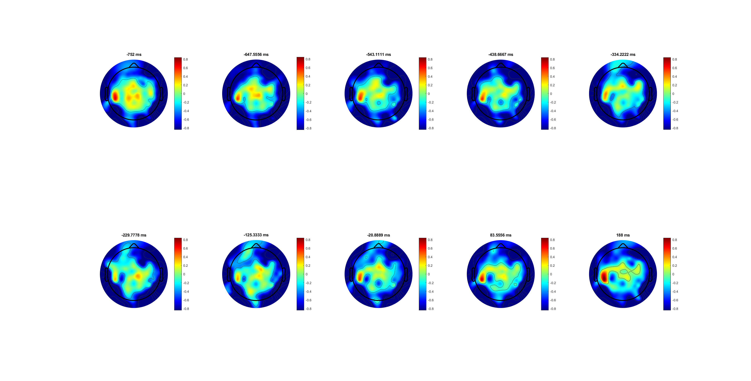
Wrong RL

Slide 46
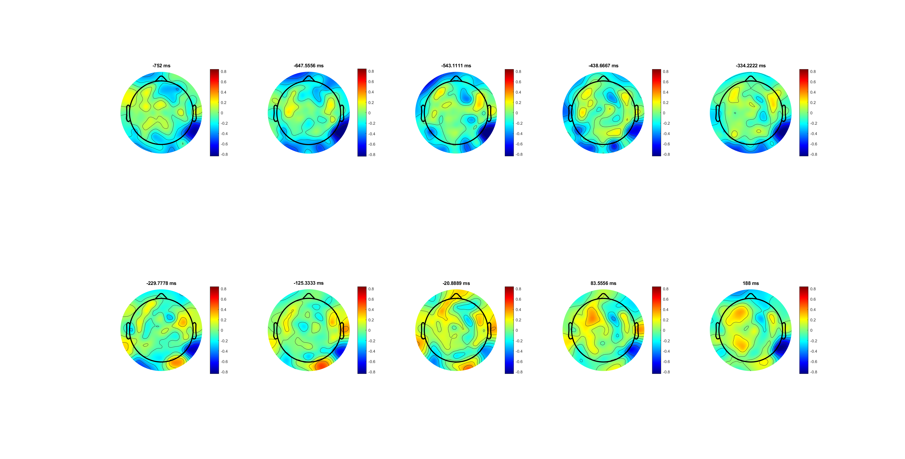
High correct
(-233 is response)

Slide 47
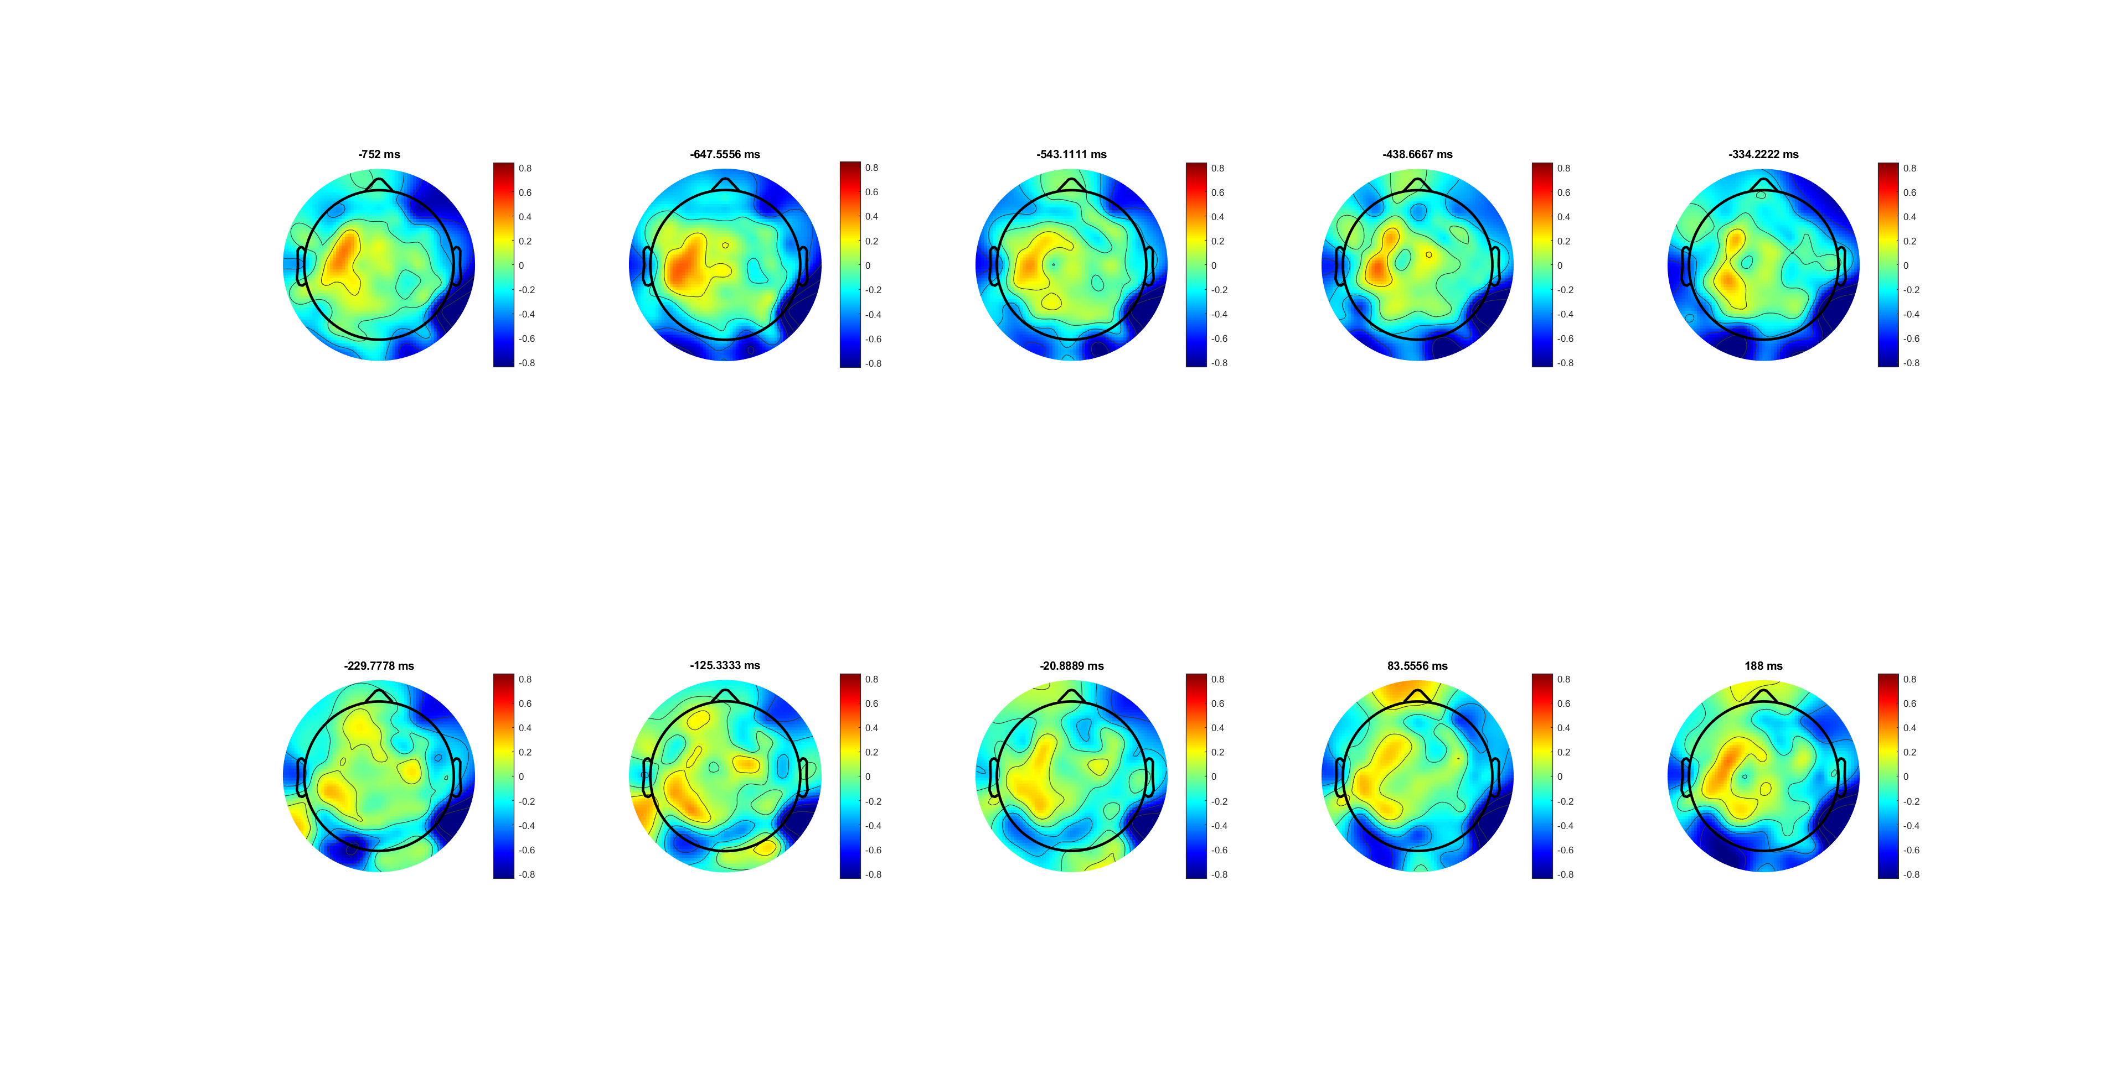
Low correct
(-233 is response)

Slide 49
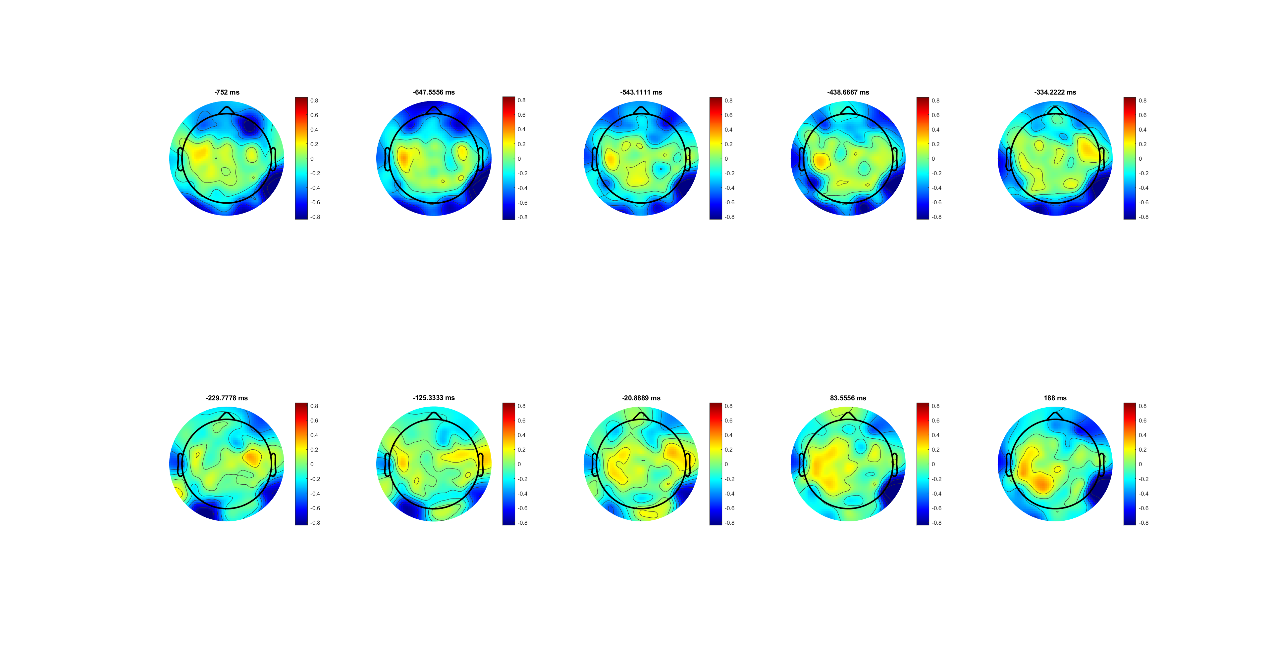
FDI correct
Both patten observed (-233 is response)
Location different

Slide 50
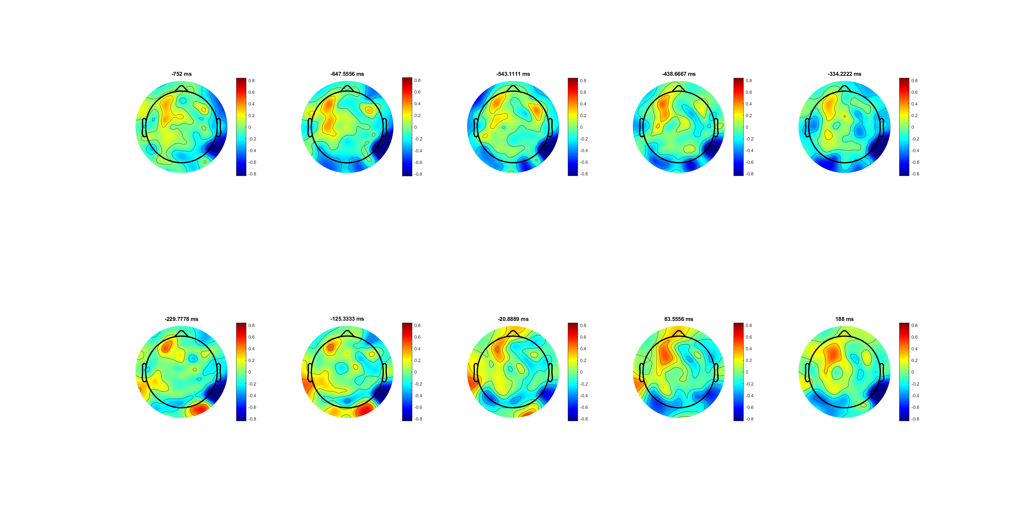
BCP correct

Slide 51
Peak at response time
BCP lower/upper (more effort/ force)
Contra lower/upper than ipsi before response

Slide 52
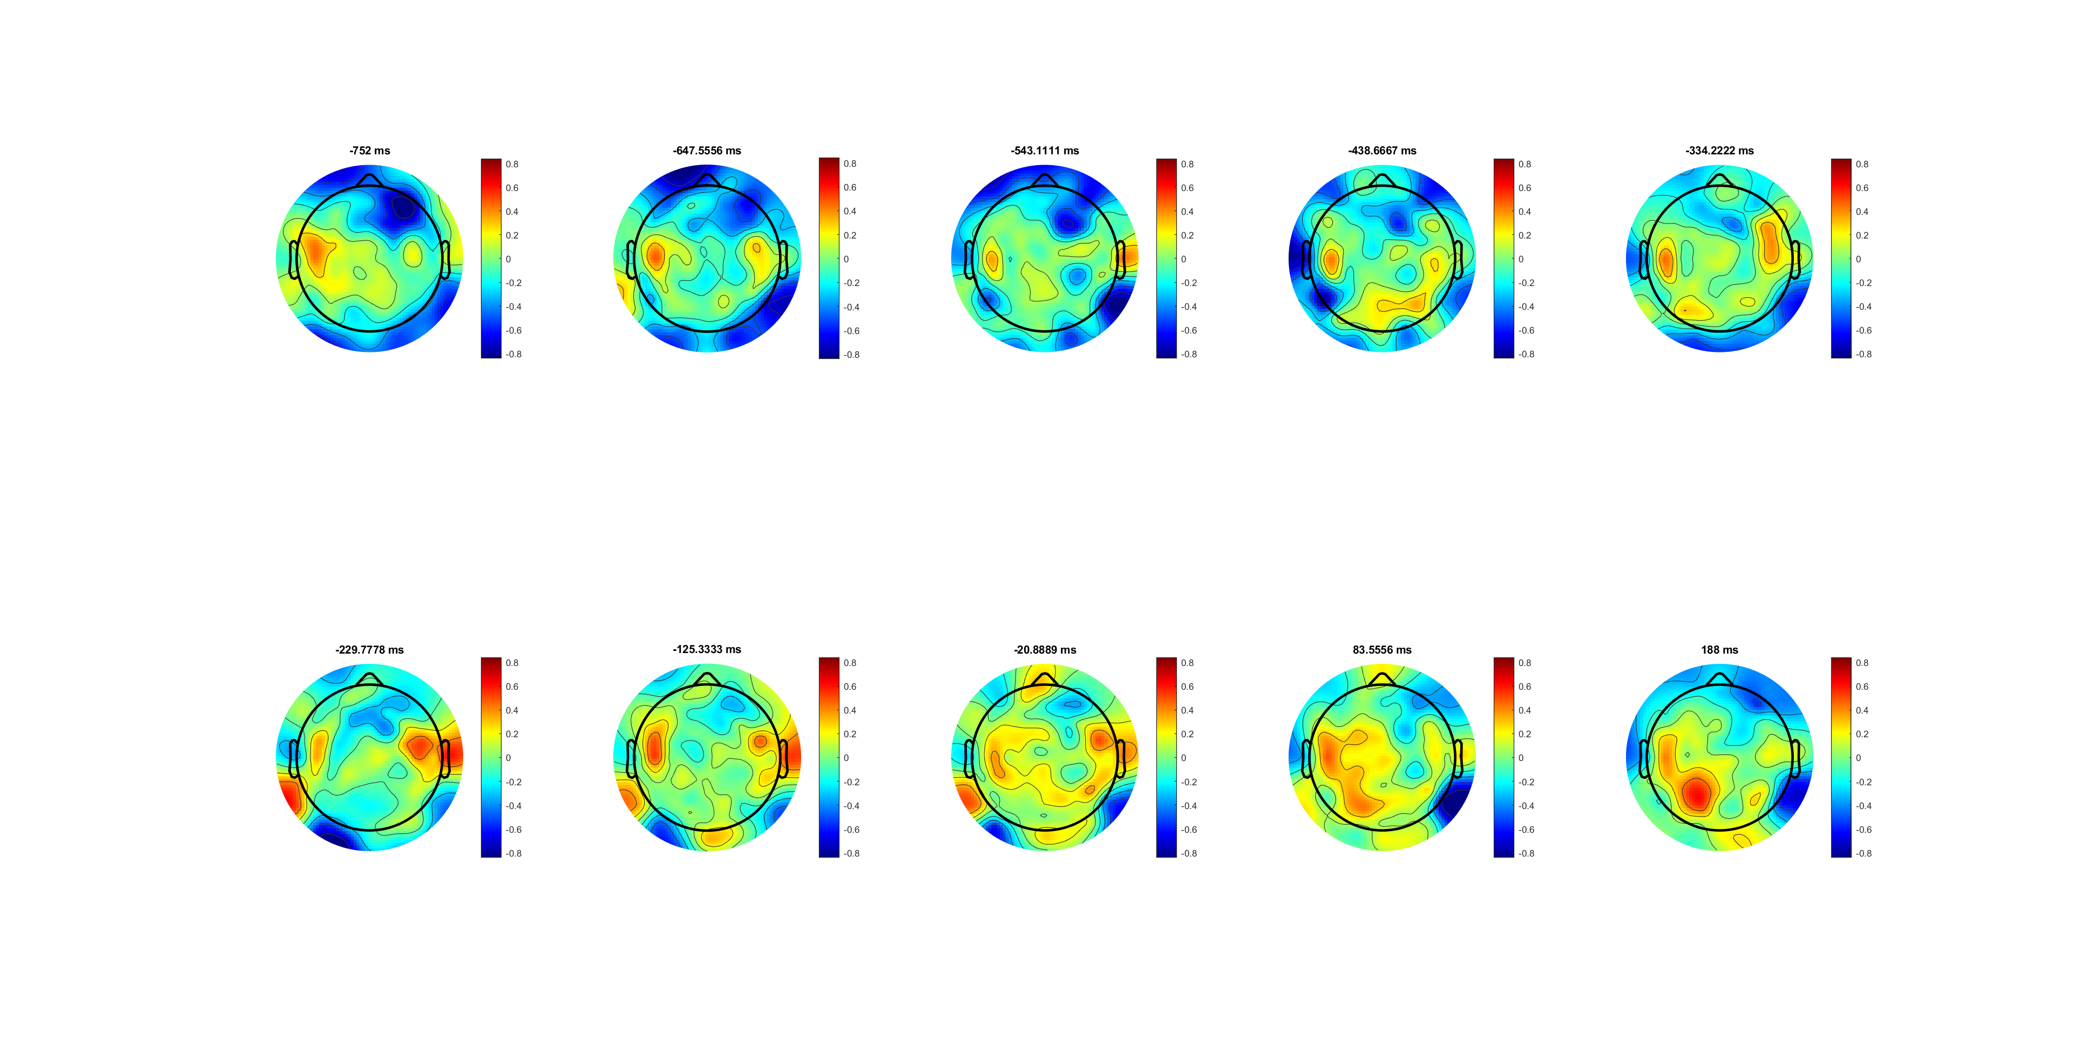
FDI correct high

Slide 53
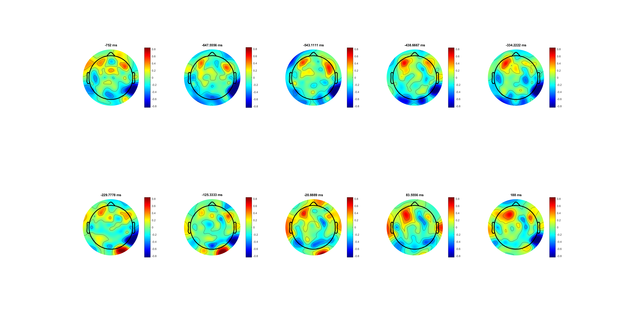
BCP correct high

Slide 54
Notes:
图不对是因为位置不对，不能比较

